Slide 1

A Better Start
Fanau Manuia Programme : a health promotion programme for Pasifika families
Massey University
Wellington

Slide 2
The Team
Ngaire Lerwill: Project Manager
Layla Latu: Research Assistant
Tupou Pulu: Research Assistant
Veisinia Pulu: Researcher
Prachee Gokhale: Research Manager (Laboratory)
Dr Marine Corbin: Biostatistician
Assoc Prof Deborah Read: Senior Researcher
Prof Barry Borman: Senior Researcher
Fanau Manuia Team
Sera Tapu-Ta’ala: Diabetes Nurse Specialist
Dr Kathy Fuge: Director, Bee Healthy
Maria Eneliko: Bee Healthy
Akarere Henry: South Waikato Pacific Island Community Trust
Dr Anna Matheson: Victoria University of Wellington
Prof Jeremy Krebs: University of Otago
Prof Te Kani Kingi: Te Whare Wananga o Awanuiarangi
Assistant Prof Nia Aitaoto: National Association of Pasifika Organizations, US

Slide 3
Background to research
LTC : Obesity, prediabetes, T2DM: place a high burden on the NZ health system & leading drivers of health inequalities among Pasifika peoples in NZ, particularly children
Risk factor profile for T2DM among children is shifting – younger cohorts developing T2DM, and it is alarming for Pasifika children:
  Obesity (27.8%)¹; High Waist to Height ratio >0.5²; Prediabetes (8.4% in youth ³), numbers too small but growing in children⁴
Childhood obesity – lifecourse predictor for obesity in later life leading to the development of co-morbidities⁵
Prevalence of 16% of prediabetes (HbA1c >39mmol/mol) among 451 Auckland children (8-11yrs) in 2022: S/East Asian (30%); Pacific (27%), Maori (18%)²
Social-economic analyses indicate persons aged 25yrs diagnosed with T2DM face a lifetime cost of ($565K), vs persons diagnosed much later in life (aged 77yrs) ($44K)⁵
Healthy People, Healthy Lives & Owning our Futures (community-centred lifestyle change programmes) - 2 of the 4 focus areas as part of a collaborated approach to a system-wide focused and population-based interventions to address the growing T2DM epidemic ⁵
Research focus: Identify a prevention window-frame for testing for prediabetes risk and to co-design a health promotion programme (lifestyle change focus), using a Pacific Family Model (PFM) approach
¹ Ministry of Health: https://minhealthnz.shinyapps.io/nz-health-survey-2022-23-annual-data-explorer/_w_4c502813/#!/key-indicators
² Mazahery et al. Pre-diabetes prevalence and associated factors in New Zealand school children: a cross-sectional study. NZMJ (2021); 134(1531): 76-90
³ Coppell et al. Prevalence of diagnosed and undiagnosed diabetes and pre-diabetes in New Zealand: findings from the 2008/09 Adult Nutrition Survey. NZMJ (2013) 126(1370),23-42.
⁴ Diabetes Toolkit 2021
⁵ Diabetes New Zealand, Edgar Diabetes & Obesity Research Centre. The economic and social cost of type 2 diabetes. Wellington: PWC & NSC: Healthier Lives, 2021

Slide 4
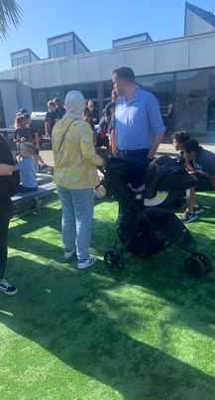
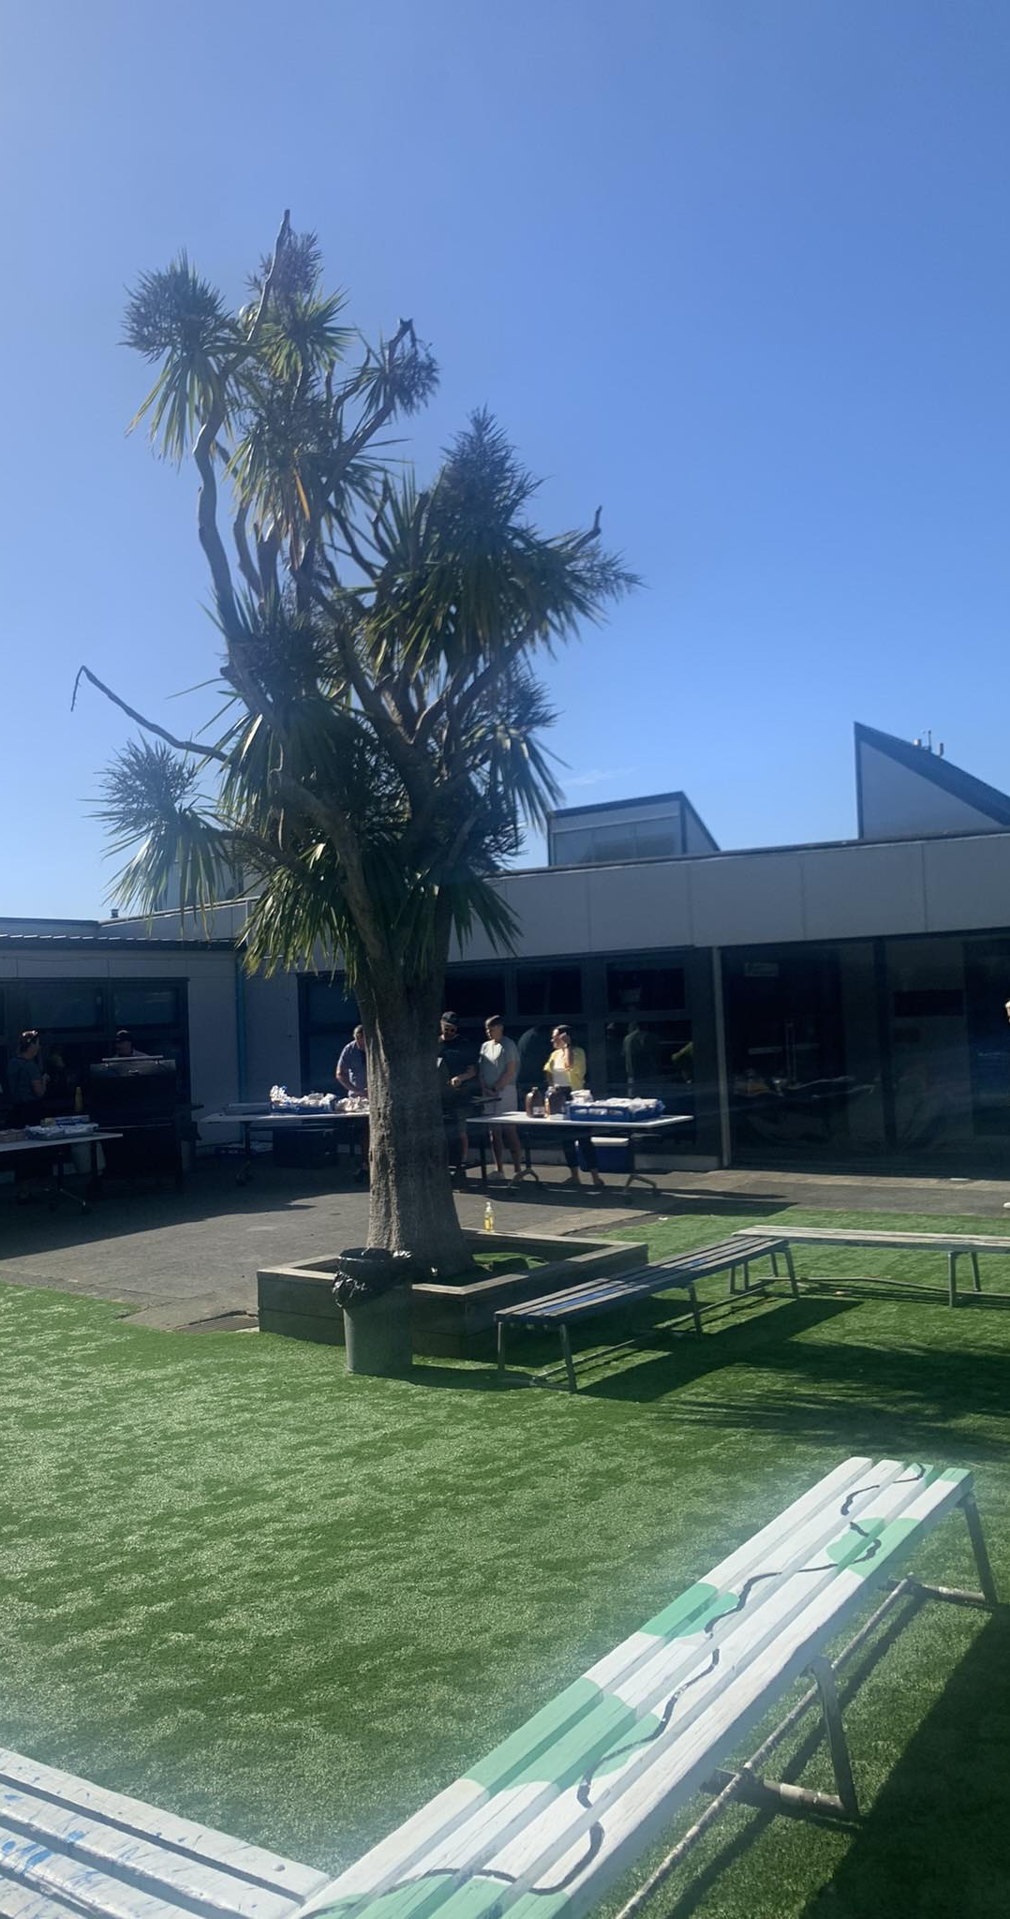
Project 1
Cross-sectional study of 300+ Wellington-based children aged 11–13-year-olds
Aim: Identify prevalence risk of prediabetes, dental health, and other health related conditions associated with T2DM risk
*Ethics approval: HDEC 2022 FULL 12212
*Not all data is presented here

Slide 5
Phase 1:
Questionnaire
Results
 | Male | Female | Total | P-value
Ethnicity (prioritized) | 51% (n=139) | 48% (n=130) | % (n=269)
Māori Pasifika Pakeha Other | 51% (71) 15% (21) 17% (23) 17% (24) | 43% (56) 13% (17) 31% (40) 13% (17) | 47% (127) 14% (38) 23% (63) 15% (41) | 0.05
Self-reported Overweight & Obese
Yes No Missing | 3% (4) 89% (124) 3% (4) | 8% (11) 91% (118) 1% (1) | 8% (22) 90% (242) 2% (5) | 0.91
1st degree relative with T2DM
Yes No Missing | 24% (34) 73% (101) 3% (4) | 25% (32) 75% (97) 1% (1) | 25% (66) 74% (198) 2% (5) | 0.94
Maternal diabetes
Yes No Missing | 9% (13) 88% (122) 3% (4) | 7% (9) 92% (119) 2% (2) | 8% (22) 90% (241) 2% (5) | 0.94
Deprivation (quintiles) (Index of Multiple Deprivation)
1 (lowest) 2 3 4 5 (highest) Missing | 29% (40) 21% (29) 20% (28) 12% (16) 19% (26) 0 | 23% (30) 13% (17) 14% (18) 18% (23) 29% (38) 3% (4) | 26% (70) 17% (46) 17% (46) 14% (39) 24% (64) 1% (4) | 0.04
Recruited : 322
Participated : 269
Non-responders : 48
Ineligible : 5

Slide 6
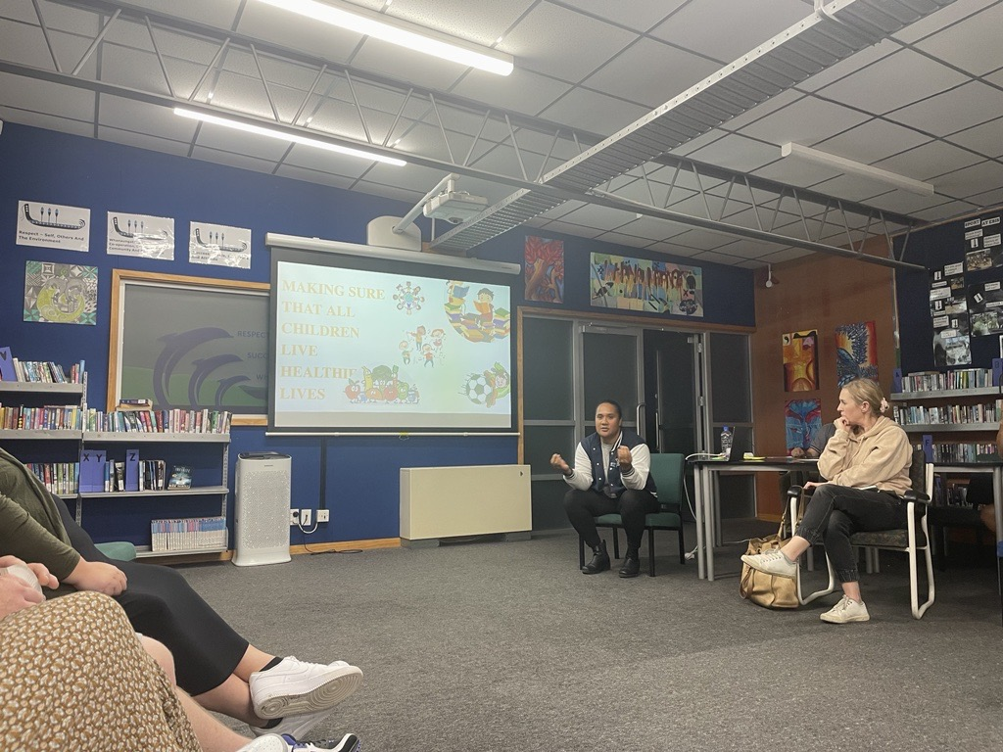
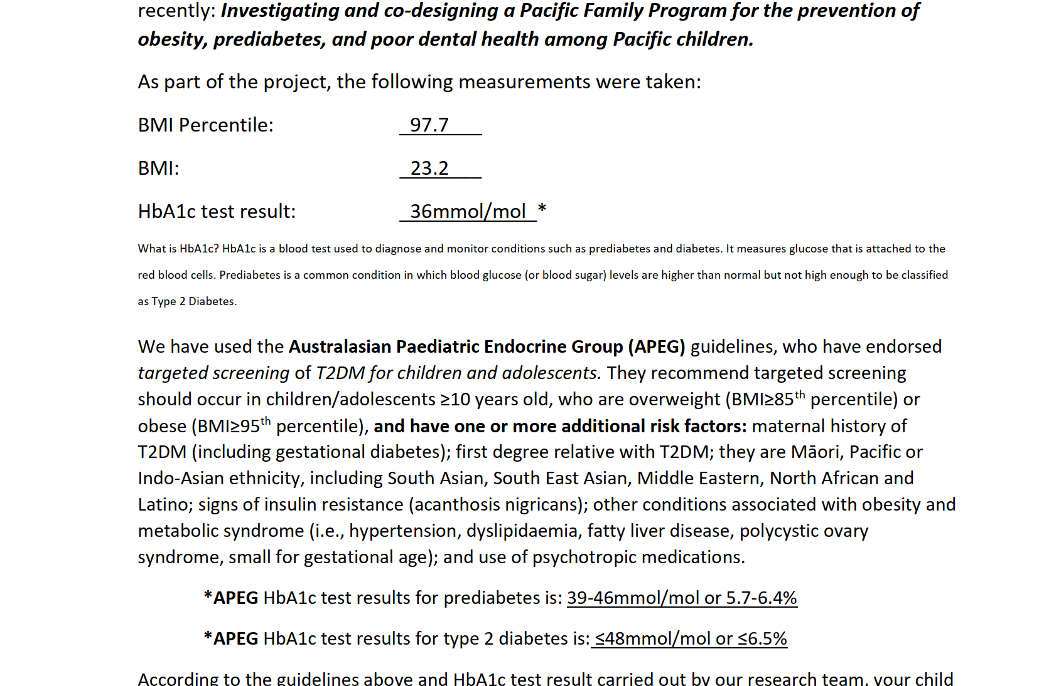
Phase 2: Testing
Requested HbA1c tests based on the APEG guidelines :
    98 children (36% identified as being at risk)
    Indicative of the need for future early testing for prediabetes
Completed: 80 children (70 of 80 were Māori and Pacific)
Ineligible : 18 children
Defined Prediabetes : n=5 (HbA1c 39-46 mmol/mol) – GP referral
Risk of prediabetes (ie risk factors + HbA1c 37-39mmol/mol)

Slide 7
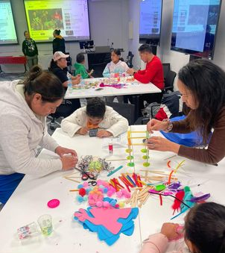
Project 2
Aim: To co-design and pilot a health promotion programme on prediabetes prevention, using a Pacific Family Model approach
Invited 25 (out 70) Pacific children and their families (Project 1, Phase 2) who fit our extended criteria for elevated risk of prediabetes
11 children and their families (of the 25) remained in the project
13-week high-intensity participation programme

Slide 8

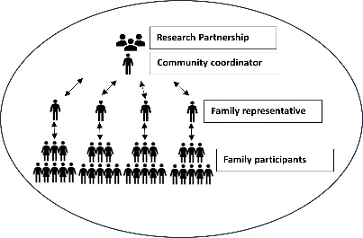



Pacific Family Model (PFM) Approach
PFM 2
PFM 1
adapted to …
Fanau Manuia Team

Slide 9

Phase 1: Family-centered Empowerment & Co-design Modules
COMMUNITY MAPPING
Physical activity
RELATIONSHIP TO DENTAL HEALTH
Health
Education
Empowerment goal:
to build and raise the capacities and capabilities of the whole family
FAMILY COOKING
Health & Wellbeing
7-STEPS
SMART GOALS
ROOT CAUSE ANALYSES
Spiritual
Health
PACIFIC FOOD SYSTEMS
Search Engine Optimization

Slide 10
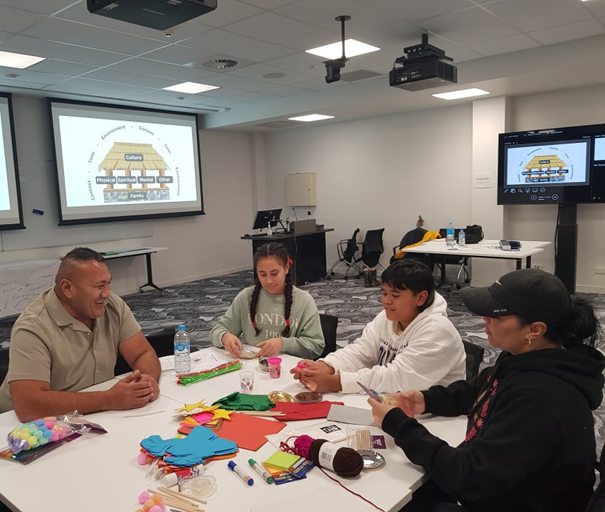
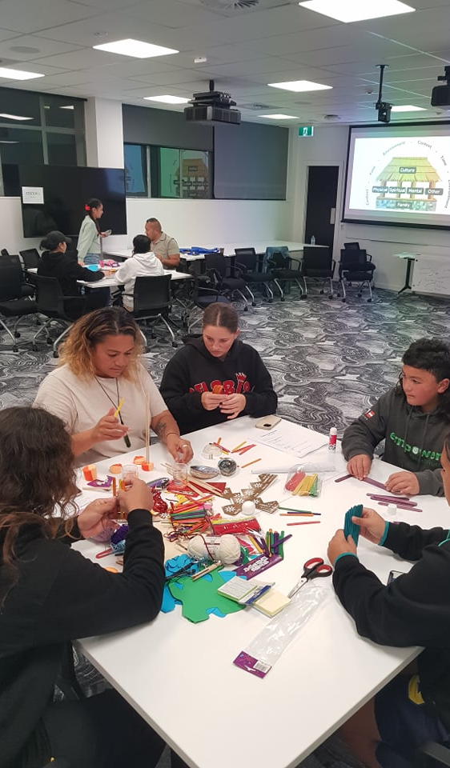
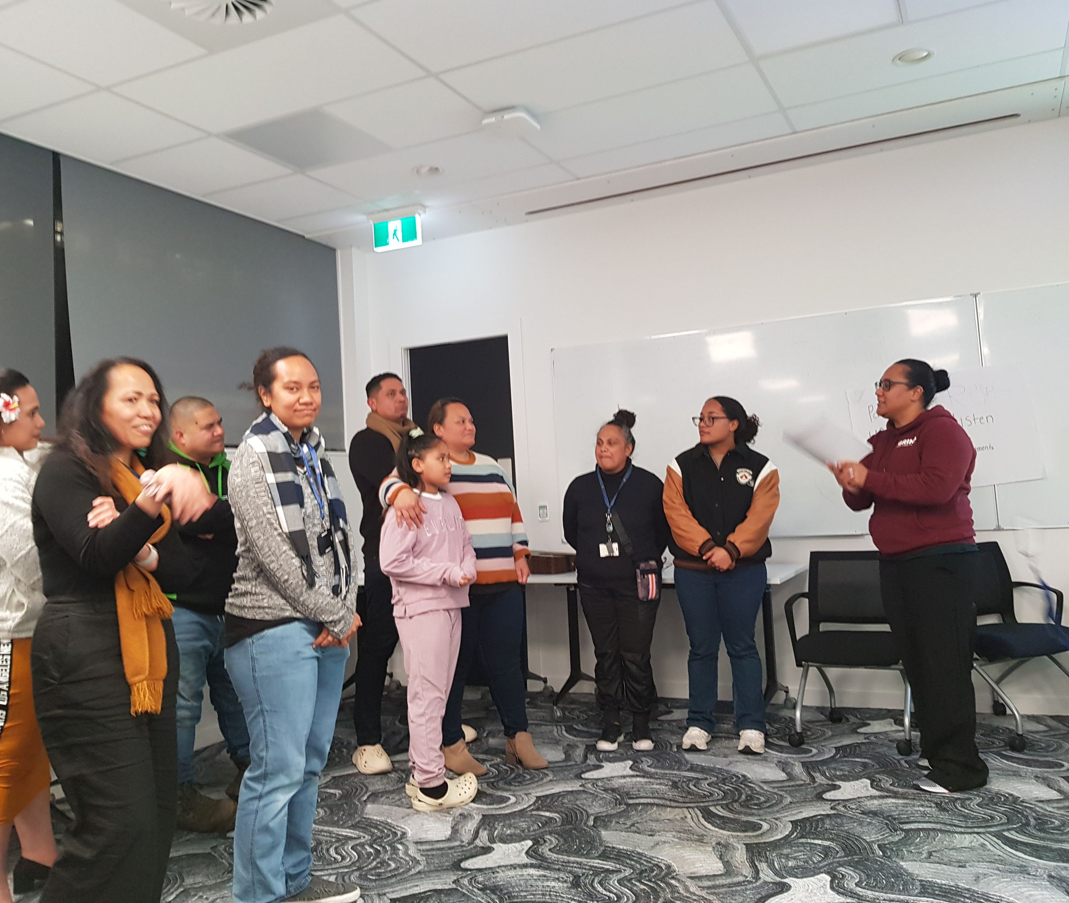
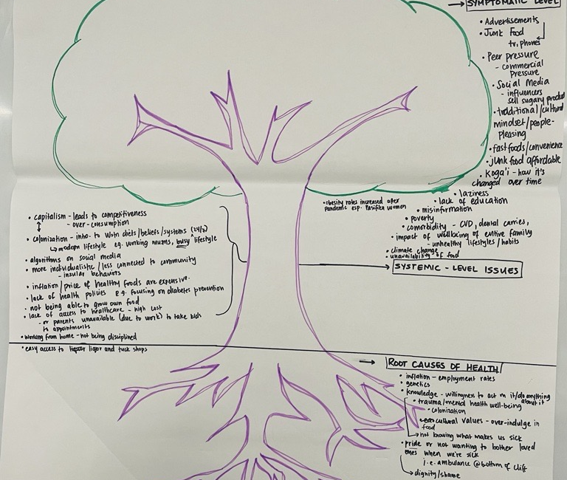

Slide 11


Goal 1: Access healthy foods
Food Baskets: 4 meals a week, cost $103-117 p/wk
Meals adapted from the Empowerment modules
  Familiar to Pacific culture
  Easy to prepare
Encouraged families to ‘prepare and eat together’

Slide 12
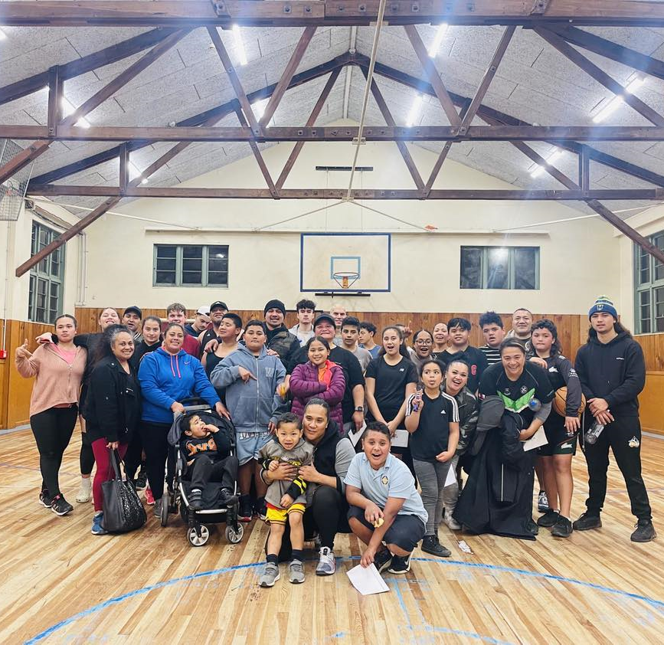
Goal 2: Enhance Family Wellbeing
Family-centred physical activities to enhance family wellbeing
  Daily family walks | individual daily goal of 7K steps
  Fanau manuia families – team-based sports to encourage family-centred focus

Slide 13

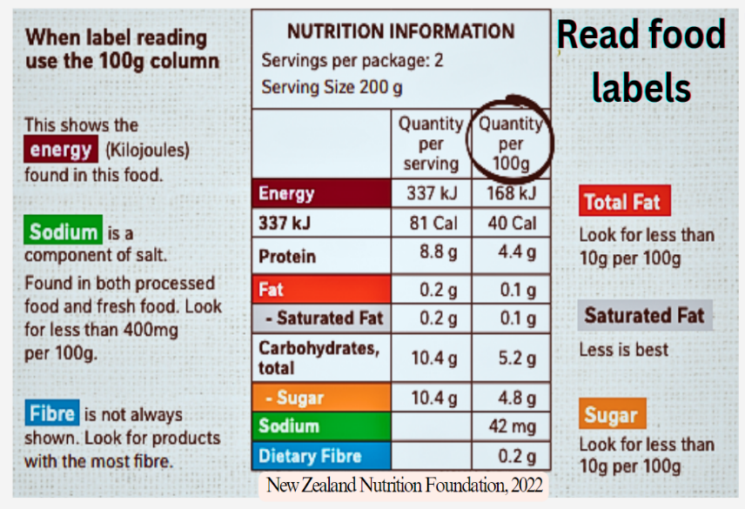
Goal 3: Grow family knowledge & awareness of healthy lifestyles
SPIRITUAL HEALTHY HABITS
Families identified topics important for their family’s health & wellbeing
Budgeting for a healthy lifestyle
Sleep Health
Food Sustainability
Understanding diabetes
Family Reflective Question:
How does striving for health habits strengthen our sense of unity as a family?
HEALTHY BEHAVIOURAL HABITS

Slide 14


Slide 15
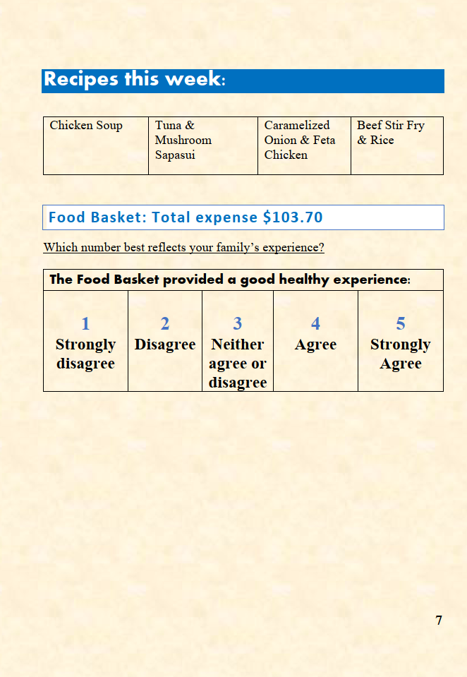


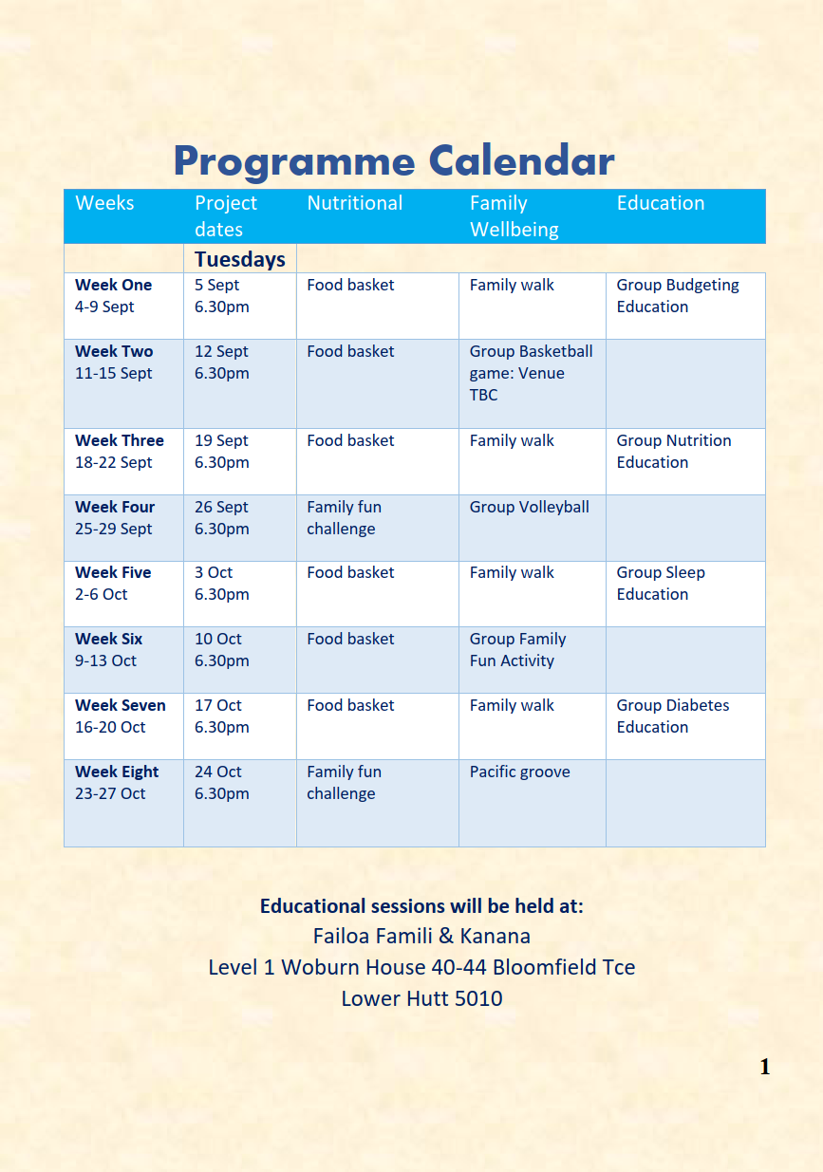

Slide 16
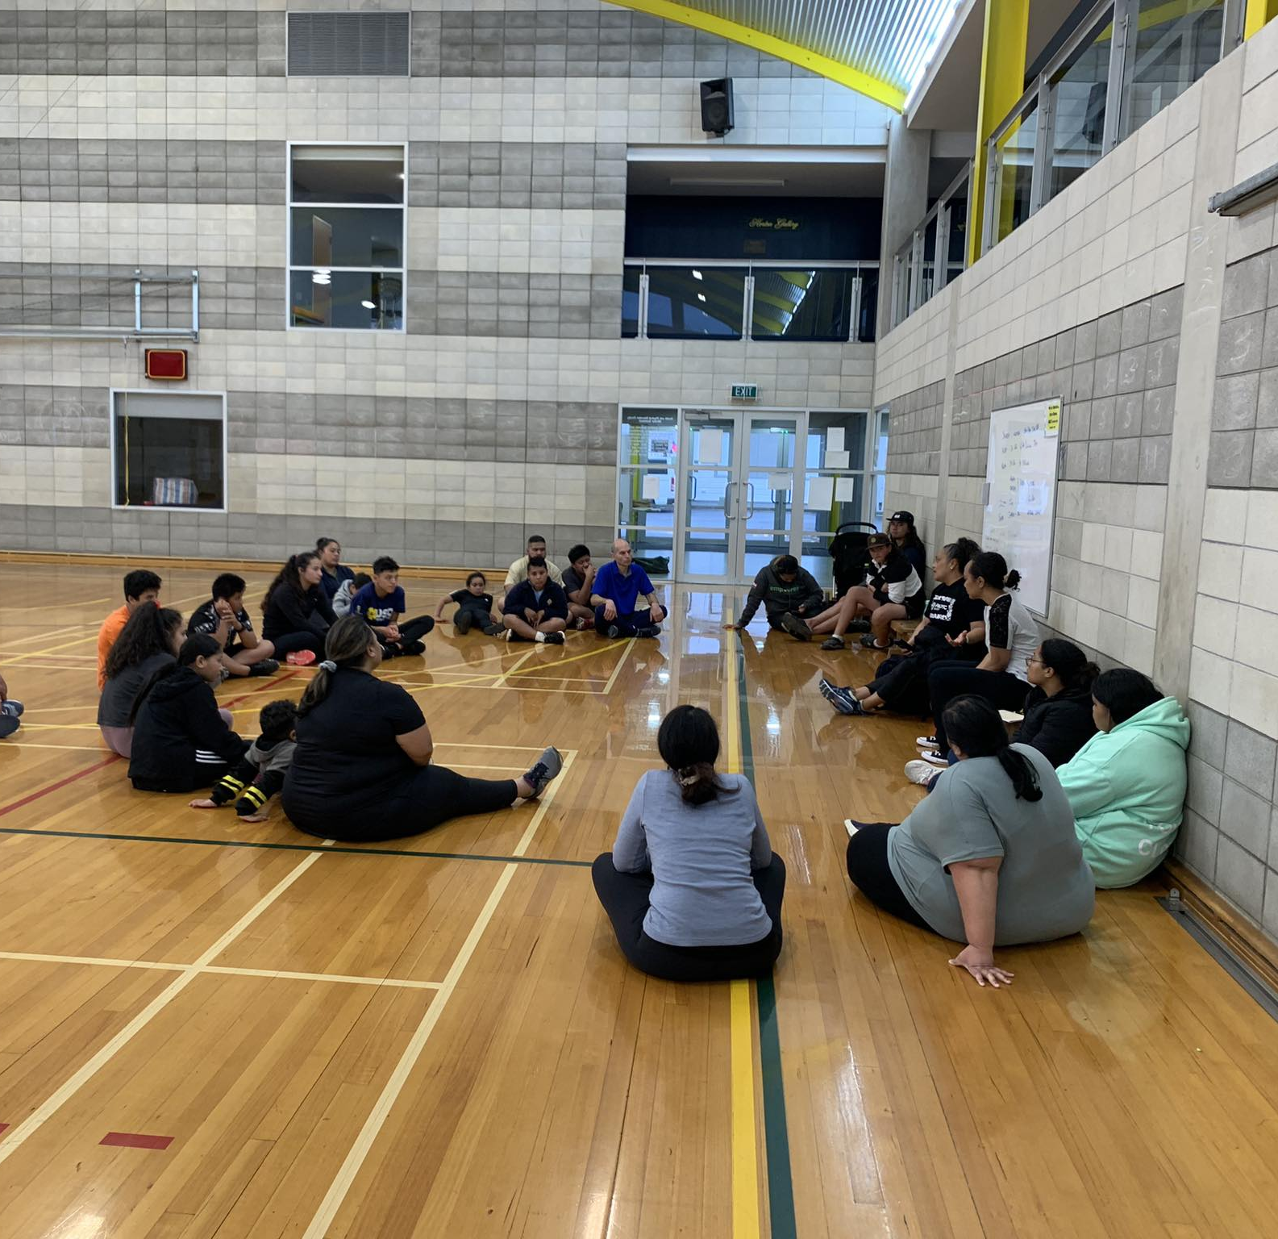
Pre- & Post-prevention programme data
Quantitative data:
Bodyweight & Height = BMI
Waist-to-Hip Ratio = centralised obesity
Hua Oranga (adapted) = Family wellbeing
Qualitative data:
Recorded feedback from Family Handbook

Slide 17
Fanau Manuia Findings…
 | Baseline |  | Post-programme
 | Children (n=9) | Adults (n=13) | Children (n=9) | Adults (n=13)
Weight (average) | 74 kg | 95 kg | 74 kg | 96 kg
BMI (average) | 96 %ile | 35 kg/m² | 95 %ile | 34 kg/m²
Waist to Hip Ratio (average) | 0.92 | 0.89 | 0.90 | 0.91

Slide 18
Family wellbeing

Slide 19
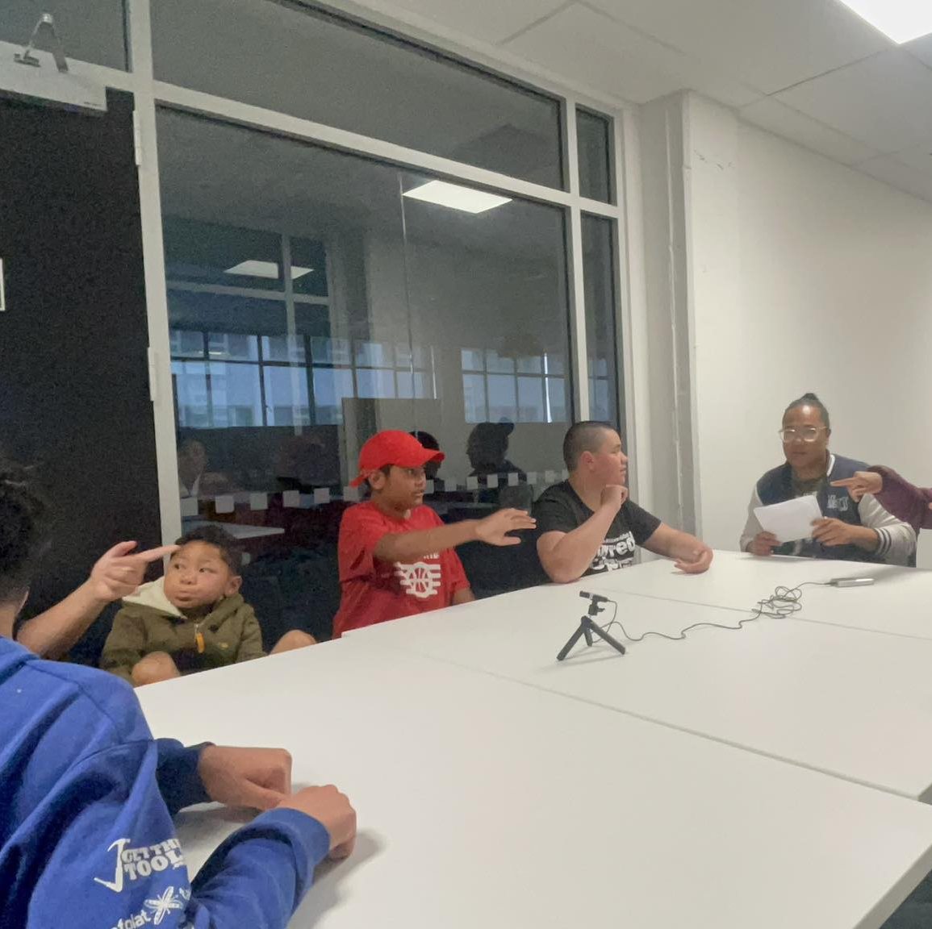
Project 3
Aim: Evaluate the Fanau Manuia Programme, with specific focus on the Pacific Family Model (PFM) approach.
Approach: Citizens Panels used for knowledge exchange and to understand the utility of the PFM approach.

Slide 20
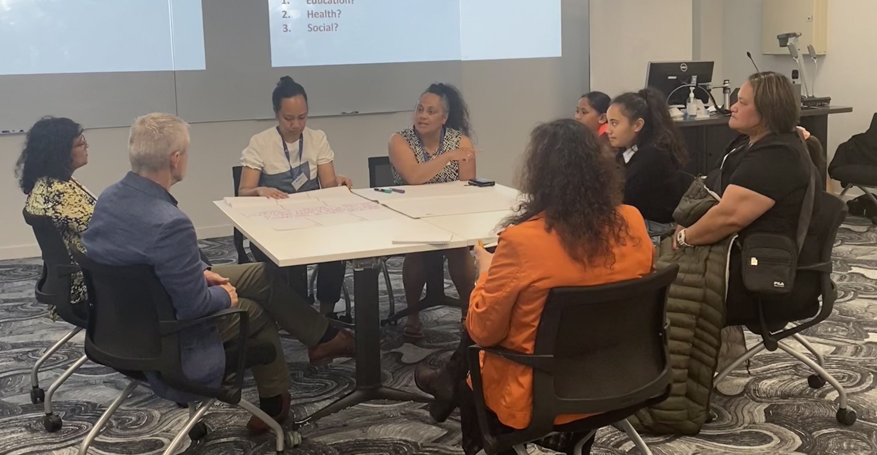
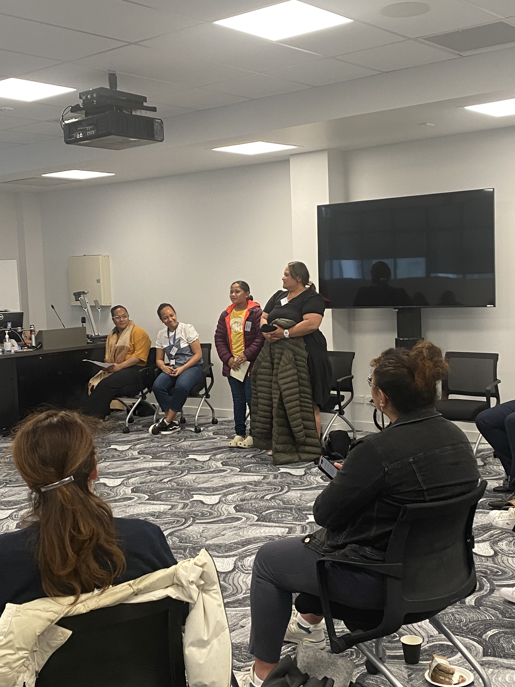
Citizens Panels
Is a developmental and dynamic way to evaluate, with the key participants at the vanguard of shared knowledge exchange and consultation
Panel 1 Families
share learnings, generate questions
Panel 2 Pacific & Māori Researchers, NGOs, Communities
shared learnings, generate questions + consultation
Panel 3 Local & Central Govt Reps, Health Societies
shared learnings, generate questions + consultation

Slide 21
Key themes – Pacific Family Model (PFM) Approach enhances…
Community context
Strong families = Strong communities
Enhances social cohesion through community engagement
PFM could be adapted for a community context – families viewed as building blocks of society
Health context
The model paves the way for ‘tailoring’ resources, strategies and inclusion of all facets of health (Fonofale model) to be included in a programme
Encourages families to read their realities of their environment – (eg. budgeting, healthy meals)
The PFM recognizes the interconnectedness of social, cultural, environmental factors of health (eg. Healthy living at church AND at home)
Social-Educational context
Used:
  Social capital
  Partner with other groups (schools, NGOs)
Created an environment for families to achieve FM goals
PFM enabled families to live a coherent lifestyle – education, sports, and church
Family context
  Builds resilience by having a common purpose in the programme
  Fosters cohesion and unity within and across families
  Enhances intergenerational connections
  Develops knowledge for all families
  Parents and children re-established meaningful discussions (eg. reflective questions = developing knowledge & cohesion)

Slide 22
What next?
Journal articles – 4 papers have been prepared are currently being peer-reviewed
Pacific student Interns - Education booklet on Foodways in the Pacific – prepared for general public access on creative commons
Dissemination Workshop – stakeholders, families and communities – planned for May 2024
Conference presentations in the US later this year
Health Research Council grants – to scale up the PFM in an Implementation Research Science Project
Discussion with NGO and other groups who may be interested in using parts of the Fanau Manuia Programme as part of their existing services

Slide 23
