Slide 1
Research translation – the holy grail?
Professor Harriet Hiscock, paediatrician
Group Leader, Health Services and Economics, Centre for Community Child Health, Royal Children’s Hospital
Clinical Innovation & Impact Consultant, Murdoch Children's Research Institute
Professorial Fellow, Department of Paediatrics,
The University of Melbourne

Slide 2
Overview
What is research translation?
Some examples from practice
Translation toolkit & other resources

Slide 3


Slide 4
What is research translation or translational research?

Slide 5
Terminology
Research translation
Knowledge transfer
Knowledge broker
Knowledge transfer and exchange
Knowledge exchange
Knowledge diffusion

Slide 6
Knowledge exchange: ‘the interaction between decision makers and researchers that results in mutual learning through the process of planning, producing, disseminating and applying existing or new research in decision making.’
- Canadian Health Services Research Foundation

Slide 7
Difficulty in translating research findings
Researchers, policy makers, clinicians and consumers
  have different agendas
  have different time frames
  use different language
  appeal to different constituencies
Yet all have common goal of wanting to improve outcomes for the population

Slide 8
Examples of translation
(successes and failures!)

Slide 9
Allergy in Community Trial
Increasing prevalence of food allergy in Australia, predominantly in children
RCH Allergy Clinic waiting list ~ 18 months
General paediatricians typically not trained in managing food allergy
Potential outcomes of delay in accessing services:
  Use of unproven alternatives to diagnose/manage food allergy
  Adverse food reactions
  Unnecessary dietary restrictions
  Adverse effects on QoL

Slide 10
REDISTRIBUTION MODEL OF CARE
Based on RCH Allergy Department strategy to develop a training program
Tertiary
Tertiary
GP/Paediatricians RCH
RCH
Secondary
Secondary
Primary
Primary

Slide 11
Redistribution Model of Care
2011/12 pilot of a Clinical Decision Support Program
  Upskilled community paediatricians (n=12) in diagnosis and care of children with less complex food allergy on Allergy Clinic waiting list (n=34)
  Community paediatricians saw these children (bulk billed)
Results
  Highly acceptable to community paediatricians
  80% uptake by families
  Paediatricians reported improved knowledge and competency in food allergy management
  93% families satisfied with care, no safety concerns raised
Danchin M et al. Managing simple food allergy in community settings: a pilot study investigating a new model of care. J of Paediatrics and Child Health. 2016 Mar;52(3):315-20.
Notes:
A clinical decision support program was developed and piloted by our team back in 2012
Highly acceptable
Good uptake
Families were very satisfied

Slide 12
Allergy in Community Trial (ACT) - Methods
Design
Before-and-after Controlled Trial
Control cohort recruited then Intervention cohort
Participants
Children 0 – 12 years old with ≤ 3 suspected allergic foods on RCH Allergy Clinic waiting list*
Followed up at 6 and 12 months post consent; retention rate: 82-95%
* anaphylaxis and severe eczema excluded
Primary outcome = time to be seen
Notes:
First recruited CC
Desired SS then recruited the IC contacted GP to re-issue their referral and removed from WL
Also has ISO – When recruiting IC.
They are still part of the IC as this reflects what happens in the real world
Roll out – not choose to see a paed.
Deb poole and other triaging staff I.D
SIMPLE FOOD ALLERGY
Assessed eligibility phone Screening questions
Explained benefits and possible downsides – sooner and gap fee
6/26 bulked billed (23%).
Max gap fee $265 for one appt
Consent online/survey – enrol

Slide 13
Methods
Intervention
Initial and follow-up consults by community paediatricians
Annual reviews by same paediatrician or child’s GP
Paediatrician completed Consult Record* for every child seen
Control
Standard care through RCH Allergy Clinic (initial consult by RCH paediatric allergist; follow-up by clinic or GP)
Allergist/trainee allergist completed Consult Record* for every child seen
* Study - designed, allowed us to measure quality of care
Notes:
After they were trained
Annual reviews if diagnosed with a food allergy.
GPs were also trained

Slide 14
Paediatricians
Working in the areas from where children were referred
No prior formal training in food allergy
Training
Program developed by RCH Allergists & 3 general paediatricians
3 x 1-hour webinars + 3 online clinical decision support flowcharts
Parent education materials embedded in flowcharts (downloadable PDFs)
Notes:
Mapped out CC kids as recruited first
BASIS for recruiting paeds for IC cohort – recruited from APRN (Australian peadiactric research netwrk) and also from RCH list of private paeds.
Paeds recruited just before IC recruitment ready see first IC families
MAP
TRIANING –
Evenings
Ige, non-ige,FA & eczema and study processes
Clinical scenarios and CDS flowcharts required to use for trial children
RCH allergist expert and facilitator
Encouraged watch live to post questions
Watch offline

Slide 15
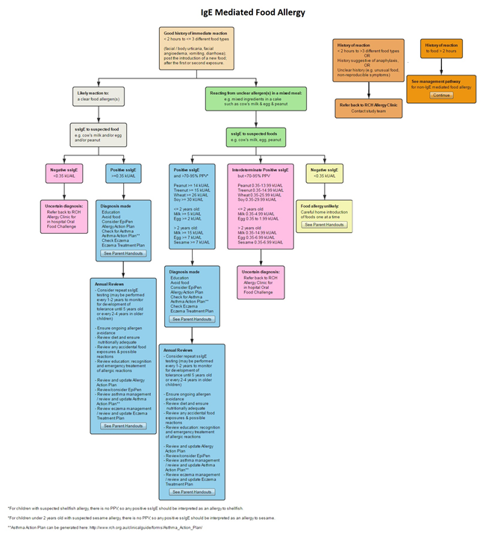

Slide 16
Median time to be seen:
Intervention Cohort: 2 months
Control cohort: 12 months
P=0.0027)
Hiscock H, et al. Improving timely access to food allergy care: A pragmatic controlled trial. Allergy. 2020 Jun;75(6):1449-53.
Notes:
Survival analysis
No surprise here but worked and this study provides the evidence of what we know.
Median time being seen is approx. 2 months in the IC group and 12 months for CC group?
IC not at 0 as the ITT IC contains the survey only group.

Slide 17
Other outcomes
Intervention vs control families:
  fewer adverse food related events
  more satisfied with overall care
  less food-allergy related anxiety
  no difference in quality of care received

Slide 18
Translation
Some success in rural Victorian program run by RCH Allergy
Resistance in urban settings from local allergists to roll out model to community paediatricians
Lessons learnt
  just because something works and patients love it, don’t expect it to be translated!
  need to keep working on relationships with key stakeholders

Slide 19
COMPASS - COnnecting Mental-health PAediatric Specialists and community Services
https://nwmphn.org.au/resource/compass-connecting-mental-health-paediatric-specialists-and-community-services/

Slide 20
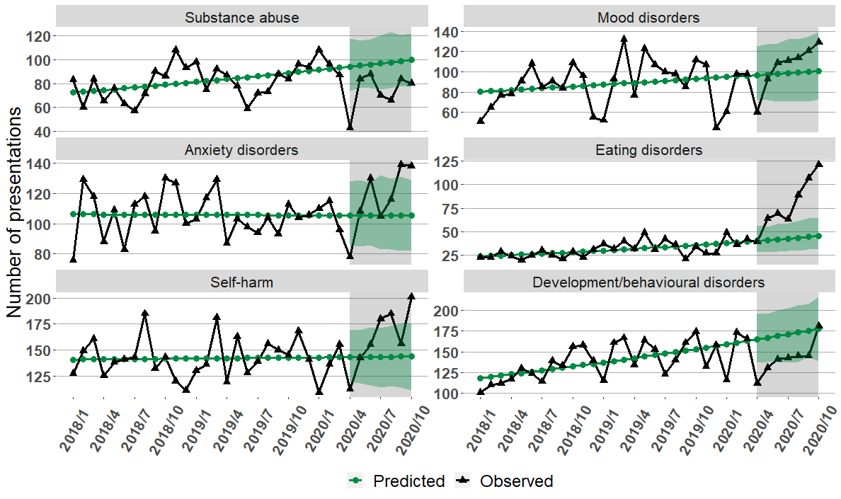
Mental health problems increasing in children – often end up in Victorian EDs
Hiscock et al., Australian Health Review 2022

Slide 21






Solutions: pathway to improving mental health
Challenge
Inadequate care
Challenge
Supporting parents, siblings and wider family
Challenge
Fragmented care
Challenge
Long wait times and high costs
Challenge
Knowing where to get help
Challenge
Clinicians and families distinguishing mental health issues

Slide 22
Solution
COMPASS - COnnecting Mental-health PAediatric Specialists and community Services
  5 x monthly Community of Practice sessions for local GPs, paediatricians, psychologists, nurses in topics of choice e.g. self-harm, eating disorders, anxiety, gender issues
  RCH Child and Adolescent Psychiatry primary and secondary consultation service
Results
  clinician confidence and competence to manage child mental health conditions
  referrals to RCH Child and Adolescent Mental Health Service (estimated cost saving of $1M per year)
  clinician burnout

Slide 23
COMPASS
Improved clinician knowledge about how:
  services are organised (16%)
  to access mental health services (15%)
  diagnose MH conditions (11%)
  to refer children and adolescents (20%)
“I had one particular young girl who I was very concerned about with increasing self-harm and suicidal ideation, who had presented to the Emergency department on more than one occasion and been discharged with a referral to community services who were experiencing significant strain. Her parents were extremely worried about her and I could see her withdrawal and deterioration with each consult. She had referrals in place ….and was on numerous waitlists …. With the aid of the mental health community I was able to utilise psychological strategies, commence appropriate medication and provide her parents support and education to continue to support her. I have no doubt that the outcome would not have been as positive if I had not been able to utilise my peers in this way….” (GP)

Slide 24
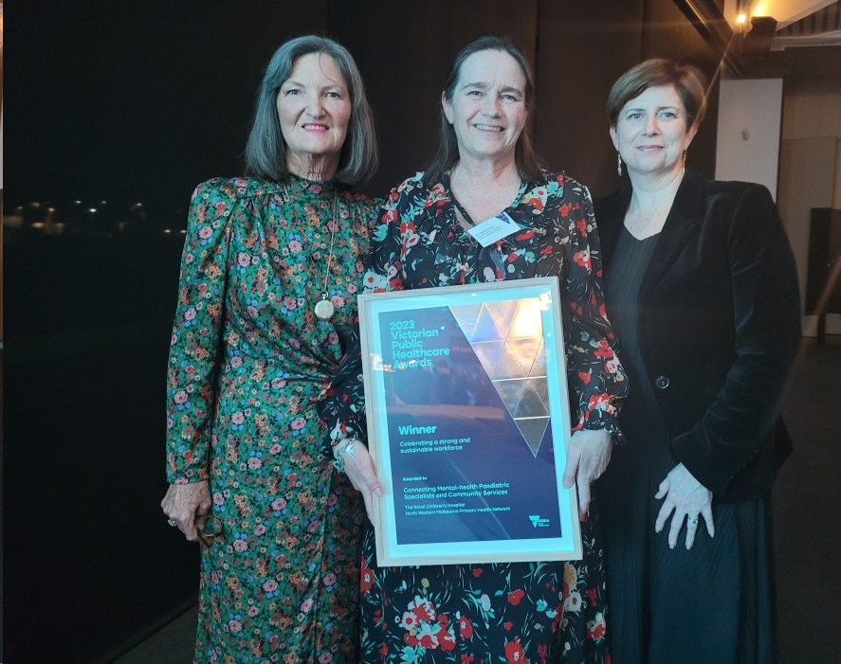
COMPASS – continues 3 years on
Lessons learnt:
- co-develop your intervention
- pilot
- engage ALL stakeholders, esp those who oversee the budget(s)
- collect the data that matters to all your stakeholders (not just you)
- show ROI (health economists are your friends)
- make sure what you designed is feasible and sustainable – we engaged NW Melbourne Primary Healthcare Network to administer the community of practice

Slide 25

The REducing MEDications in Infants (REMEDI) Study

Slide 26
REDucing MEDications in Infants (REMEDI)
Multi-site study to reduce unnecessary prescribing of acid suppression medication in infants
Co-designed intervention to reduce hospital prescribing
Co-design informed by interviews with 20 parents and 10 clinicians
        Eastern Health (Box Hill and Angliss hospitals), Golburn Valley Health, and Peninsula Health
Pre-post design with clinician & family surveys, patient file audits, and hospital prescribing data

Slide 27
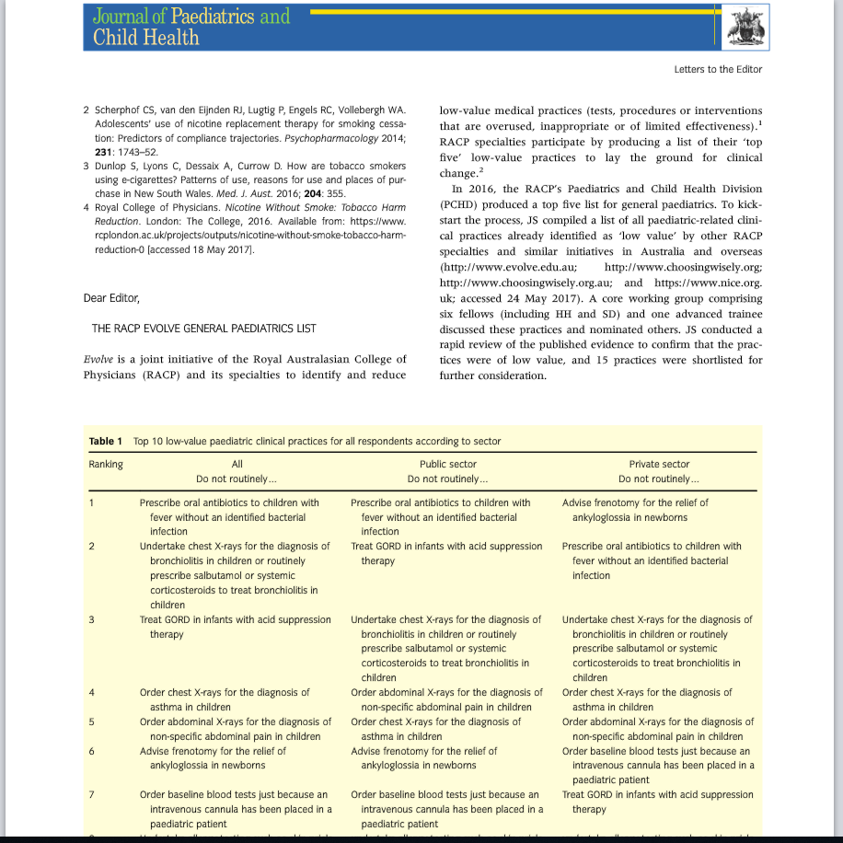
Why acid suppression medication?
RACP Top 5 “do not routinely do”
Prescribe oral antibiotics to children with fever without an identiﬁed bacterial infection
Order chest X-rays for the diagnosis of bronchiolitis or routinely prescribe salbutamol or systemic corticosteroids to treat bronchiolitis
Treat GORD in infants with acid suppression therapy
Order chest X-rays for the diagnosis of asthma
Order abdominal X-rays for the diagnosis of non-speciﬁc abdo pain
Hiscock at al JPCH 2017

Slide 28
What works?
Multi-faceted better than single component interventions
Guidelines least effective!
Involving families (only 4/64 studies) is more effective than clinicians alone
….but only 1 RCT – ie low quality evidence!
Hiscock et al, Pediatrics 2018

Slide 29
Barriers to reducing Low Value Care
Clinician
Lack of guideline knowledge
“Cook book” medicine
I might miss something
Disagree with the evidence
Uncomfortable with NOT doing something…
Lack of alternatives
Lack of time
Family
Want tests/treatments (do they?)
Parental anxiety/ need for reassurance
Belief that more = better

Slide 30
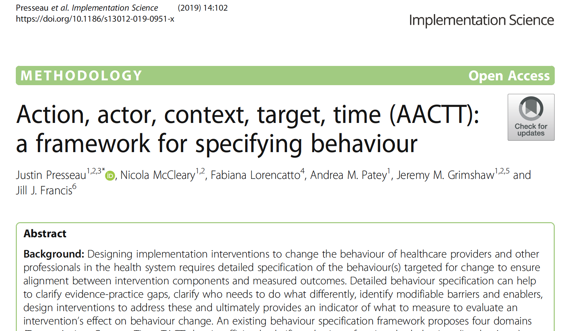
Who needs to do what differently? AACT framework
Action
Specify an action that can be observed or measured
Actor
Specify the person or people who does or could do the action
Context
Specify the physical location, emotional context or social setting
Target
Specify the person or people with or for whom the action is performed
Time
Specify when the action is performed (time, date, frequency, duration)

Slide 31
Who needs to do what differently?
Applying the AACTT framework
AACTT specification: reduce acid suppression prescribing or stop existing AST
Action | Stop prescribing acid suppression medication | Wean infants off acid suppression medication | Settle infants without medication
Actor | Hospital paediatricians | General practitioners | Parents
Context | In-patient ward, special care nurseries | General practice | Hospital admission
Target | Infants and their parents | Infants and their parents | Infants and their parents; nursing staff
Time | Every admission for a healthy unsettled baby | Every consultation for a health unsettled baby | Every admission for a healthy unsettled baby

Slide 32
What we did
Co-design interventions with parents and clinicians across the 4 sites
Suite of interventions:
  Local champions (nurses and doctors)
  Parent, hospital clinician and GP written resources
  Onsite education, incl. management flowchart, how not to prescribe and what to do instead
  Videos for clinicians, posters for families and clinicians
Train clinicians in PDSA cycles

Slide 33
Did it work?
With the caveat of pre-post evaluation…yes!
  reduction in unnecessary AST prescribing by 21%
  increased number of parents advised to cease AST by 46%
  increased parent knowledge that AST causes harm by 19%

Slide 34
What worked?
Trusted clinical champions
Consumer input to design
  highlighted importance of teaching clinicians how to talk about crying babies
Clear receptor site(s) for end products (sustainability)
  resources linked to statewide Clinical Practice Guidelines, PHN HealthPathways (GPs)

Slide 35
Some non-traditional ways of thinking about translation
www.sleepwithkip
https://www.matterworks.com.au/

Slide 36






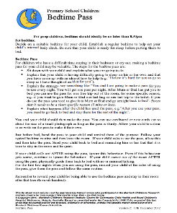





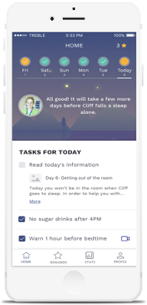



Sleep with Kip ‘Teaching Australian children healthy sleep habits’
The Innovator
The Problem
Pediatrician & researcher
Prof Harriet Hiscock
Professor Harriet has led over two decades of research into baby and child sleep. Along with her team, she has conducted world-first trials of parent-led strategies to improve infant sleep, sleep in primary school aged children, and in children with ADHD. Sleep with Kip brings together two decades of internationally renowned work to provide evidence-based support for children and families.
Behavioural sleep problems affect 30% of children (& parents), impacts mental health, work & school performance and quality of life and unnecessary referrals to specialists & sleep clinics
Sleep with Kip – an innovation journey
Sleep well Be well app
Planning sustainability for the Sleep with Kip brand
20 years of infant and child sleep research
20,000 books sold
PJs & Kip toys available across Australia
2001
2019
2022
2023
2024
FROM RESEARCH TRIALS… TO CHILDREN & FAMILIES

Slide 37
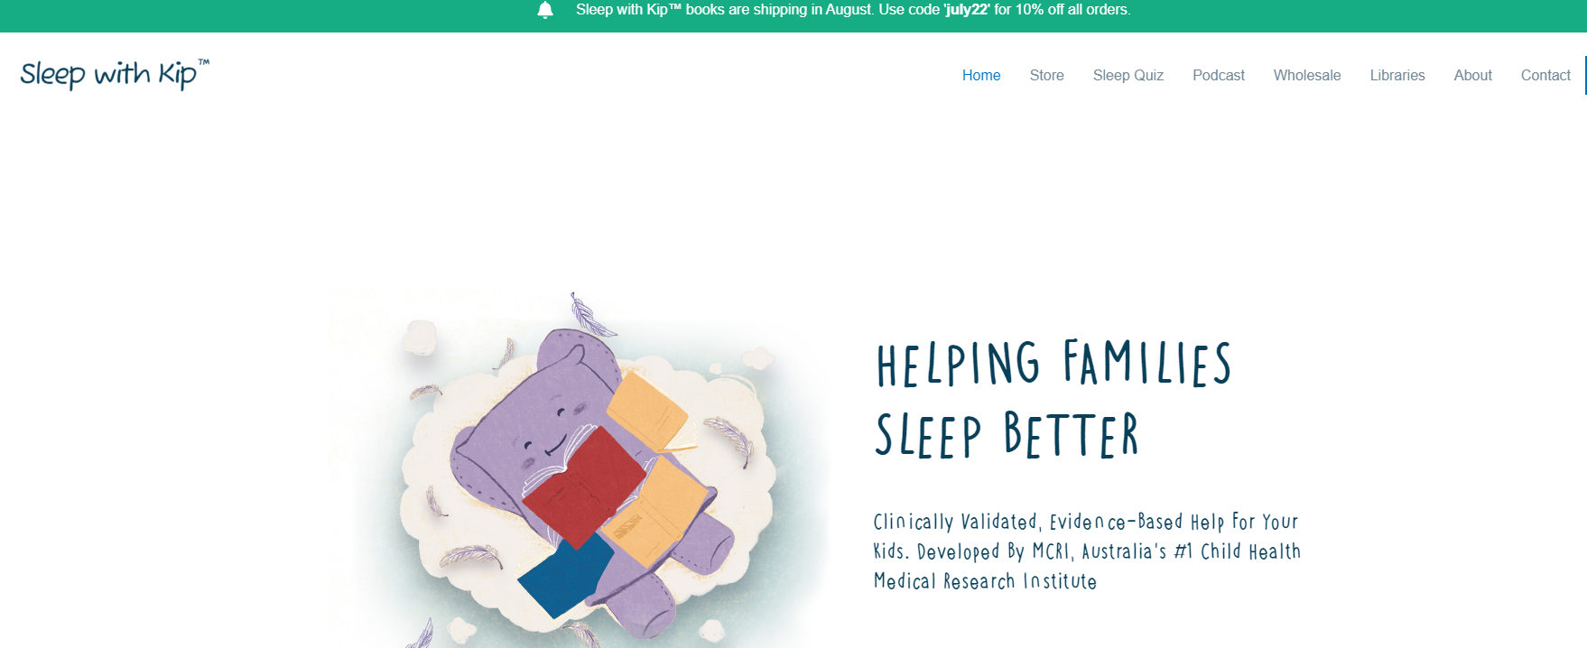
Sleepwithkip.com
sleepwithkip.com – books, audiobooks,
Brings together 2 decades of our sleep research @ MCRI
Books + audiobooks
Sleep Quiz for parents to complete
MCRI Sleep podcasts – from babies to teenagers and for Sleep and ADHD and Sleep and Autism

Slide 38


Sleep onset association disorder
Camping out
Checking method (aka controlled comforting)

Slide 39


Scared to go to sleep
Establish if they are really scared OR it’s a ‘curtain call’
If scared: reassure, try reading this book:
If a ‘curtain call’, try bedtime pass method:

Slide 40

Anxiety-related insomnia
If there is anxiety:
  find out what/why and address it if possible
  1-10 happiness scale for school/kinder and home
  ‘worry book’ – write/draw worries and shut the book on them until the morning
  relaxation exercise + visual imagery
If not better after 2-3 weeks, refer to psychologist

Slide 41


© Matterworks 2022
Humanising health research

Slide 42



OVERVIEW
Hello.
We are a content & technology studio
Co-Founders Kylie Robertson & Sarah Wyse share a common vision to leverage their 20+ years experience in media & entertainment to create a more equitable world through digital health literacy.
We translate
health research into entertaining & culturally relevant content for young people
We believe by connecting world class health research to generational media trends we can create smarter, stronger, & healthier future generations.
We partner with global leaders in health research, tech, & education
Our vision is to become the world’s leading source of health literacy for young people & their communities.
Together with our partners, we are working towards building an agnostic digital health ecosystem for good.
Hear from the Co-Founders
Watch a sample of our content
Hear from our partners
Commercial In Confidence I © Matterworks 2022

Slide 43



PARTNERS
Our partners
Our global partnerships philosophy enables us to work with a range of partners to deliver evidence-based health literacy products to young people & their communities.
Research Partner
Murdoch Children’s Research Institute is Australia’s largest child health research centre & one of the top three child health research institutes worldwide for research quality and impact. The institute brings together the brightest minds in research to solve the biggest health issues for children.
Murdoch Children’s is closely affiliated with global research counterparts LA Kids, Boston Children’s, & Great Ormond Street in London.
Education Partner
Education Perfect is the leading EdTech provider in Australian & New Zealand reaching over 50% of Australian Schools. EP’s platform is about creating an inclusive system that provides accessible, affordable and high-quality education.
Global investment firm KKR has taken a majority stake in Education Perfect that values the New Zealand-based edtech company at $NZ455 million ($424 million).
Content Partner
Raising Children Network is Australia’s largest parenting website & provides free, reliable, up-to-date & independent information to help families grow & thrive. Raising Children is funded by the Australian Government & provides expert advice to parents.
Commercial In Confidence I © Matterworks 2022

Slide 44


PROGRAMS
Our latest initiative tackles mental health literacy with the help of neurodiverse social media creators, athletes & activists
Matterworks together with Murdoch Childnre’s Research Institute & Education Perfect, has launched Decode Mental Health & Wellbeing - a video-first, curriculum-aligned mental health literacy program for students (Years 5-8) & a podcast-led teacher professional development program.
Decode is the only evidence-based program available in Australian schools that is curriculum aligned & designed with the student in mind. Our entertaining approach across both the student & teacher programs cuts through misinformation with research backed lessons, delivered in a way that reflects how audiences consume media outside of the classroom.
Watch the program trailer
Watch Episode 1 - What is Mental Health?
Commercial In Confidence I © Matterworks 2022

Slide 45


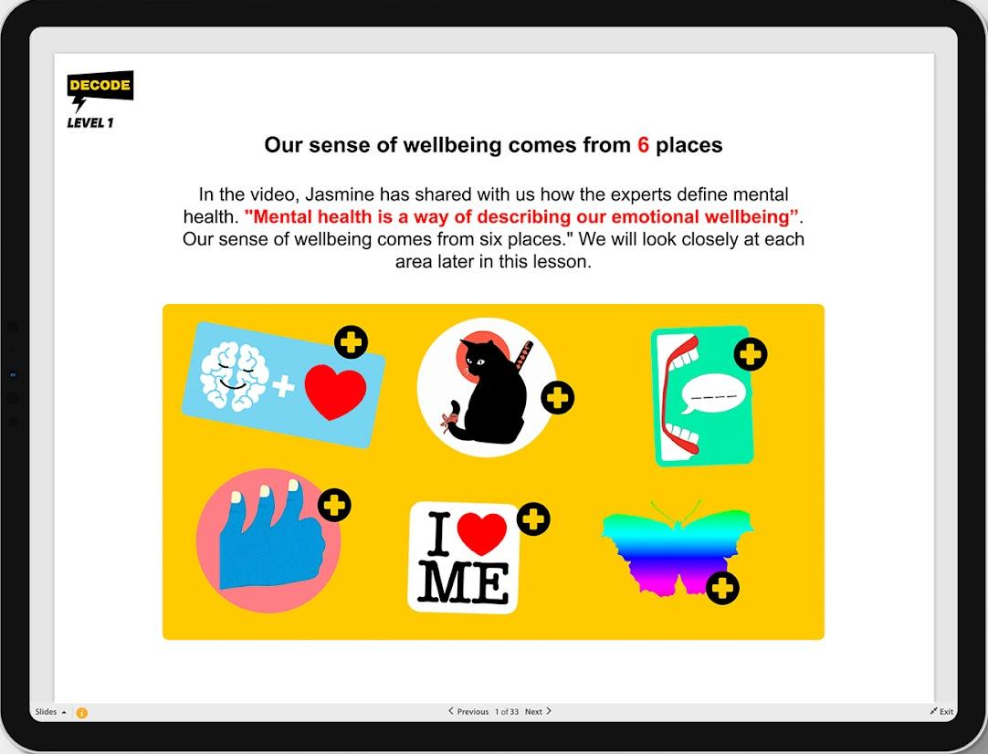

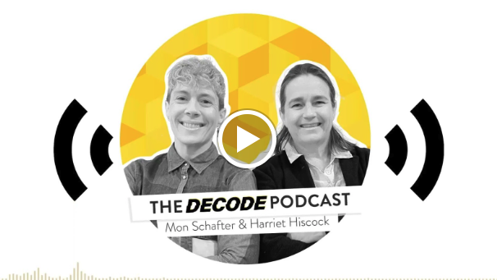
ABOUT DECODE
Rich media digital health literacy program
The Decode program is available on the Education Perfect schools platform.
It features learning modules that cover core elements of MH&W literacy for Years 5 - 8 students & teachers.
LEARNING MODULES
WHAT IS MENTAL HEALTH?
INSIDE THE BRAIN
EMOTIONS & FEELINGS
84 x media assets featuring short form video episodes, podcasts, & text based learning materials -
8 x 8 min video series (Years 5 - 8: child & adolescent mental health)
6 x 15 min podcasts (Teacher Professional Development program)
70+ lessons
RELATIONSHIPS
GENDER IDENTITY
Commercial In Confidence I © Matterworks 2022

Slide 46


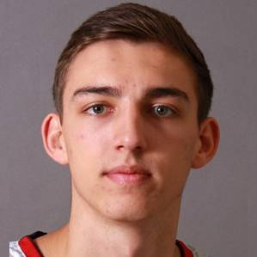


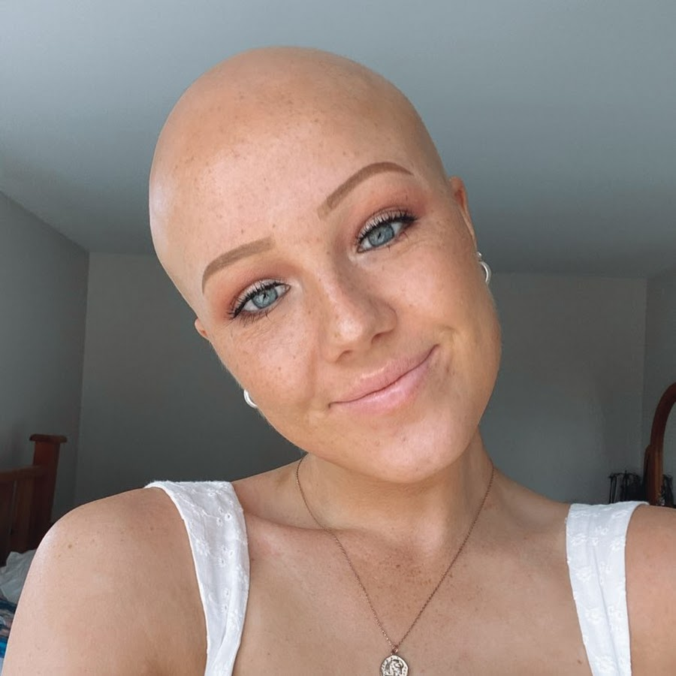





DECODE STUDENT PROGRAM TALENT
SERIES HOST: JASMINETXO
22 year old Tik Tok sensation with a following of over 5m+. Jasmine’s content focuses on mental health, spreading positivity, dance, & pop culture
Reference content
Guest: Mason Peatling, is a basketball player currently playing for the Melbourne United, having started as a development player, Mason is now part of the starting line up.
Guest: Chloe Hayden
An award winning motivational speaker, actor, performer, author, influencer, content creator and disability rights activist and advocate, the heart of which these all intersect being her passion for creating change, celebrating diversity, and pushing towards a better future. Chloe is also a breakout star of the Netflix original series Heartbreak High.
Reference content
Guest: Lily Grace, is a 20-year old Australian podcaster, YouTuber and content creator. Lily’s podcast (with her sister Georgia) discusses core memories they experienced while they were young that define them as adults.
Reference content
Guest: Olivia Archer, is a 20-year old New Zealand based creator with alopecia who creates content celebrating the unique differences each human has and celebrating self-confidence all the while being extremely honest about her journey. With a following of nearly 1.5M, Liv has a cult following online.
Reference content
Guest: Rudy Jean Rigg, is a host and activist and a founder of the Rainbow History Class. Rudy is vocal about their experiences as a queer transgender person with autism and ADHD. Rudy is host & co-writer of the soon to be launched Tik Tok documentary series, Transathletica.
Reference content
Guest: Alex Robinson, is a parkour comedian and athlete, creating content that involves his active lifestyle and highlighting his parkour abilities. With a following of nearly 1M, Alex has a highly engaged audience and is also a video director. Alex has also appeared on Ninja Warrior Australia and won an Aimco Award for “best niche creator”.
Reference content.
Guest: Xavier Munford, is a basketball player currently playing for the South East Melbourne Phoenix (NBL), having previously played in the NBA. Xavier will be virtually recording while he is on holidays in the States.
Reference content
Guest: Aya Al-Chalabi, is a digital content creator based in New Zealand of Arabic and Muslim background. Aya’s content is fun and educational, aiming to inform audiencesand celebrate diversity about the Arabic and Muslim culture.
Reference content
Guest: Win Velasco, is a Filipino creator based in New Zealand who creates celebratory content around New Zealand culture.
Reference content
Commercial In Confidence I © Matterworks 2022

Slide 47
DECODE
DECODE - Mental health literacy for kids and teachers
Victorian government funding:
  adapt DECODE for children from CALD backgrounds and First Nations children
NSW government funding:
  adapt DECODE for children with ADHD, autism and physical disabilities

Slide 48
Translation toolkit
3 steps
Brief research overview
Identify stakeholders
    - Power & Impact matrix
Design stakeholder engagement
    - levels of engagement
    - advisory vs reference groups

Slide 49
Identifying Stakeholders
Name of Stakeholder | Sector | Value to process/role | Prioritising* | Level of Commitment | Constraints / Limitations
Organisation, group or individual | Government (Local, State, Federal), Health (Primary, Secondary, Tertiary), Not-for-Profit, Community, Education, Research, Professional Bodies e.g. RASP, Business, Media, etc | Expertise/knowledge Funding/Resources Influence/Leadership Consumer Voice Advocate/Champion Technology Underrepresented | See Power & Impact Matrix. Do you need to Satisfy, Actively Engage, Monitor or Inform? | Support or Oppose the research, to what extent and why? | Need funds to participate, lack of personnel, political or other barriers
Internal Stakeholders MCRI, RCH, Uni Melb
External Stakeholders

Slide 50
Power & Impact Matrix
High power | Satisfy Opinion formers/Policy makers. Keep them satisfied with what is happening and review your analysis of their position regularly. | Actively Engage* Key stakeholders who should be fully engaged through full communication and consultation.
Low power | Monitor This group may be ignored if time and resources are stretched. | Inform Recipients of research such as Patients often fall into this category. It may be helpful to take steps to increase their influence by organising them into groups or taking active consultative work.
 | Low impact/stake holding | High impact/stake holding
Department for Business, Enterprise and Regulatory Reform www.berr.gov.uk, http://www.bis.gov.uk/files/file40647.pdf

Slide 51
Stakeholder engagement
Name of Stakeholder | Potential level of Engagement *The level of engagement is likely to change at the different stages of the project. | Engagement Method
Organisation, group or individual | Information giving Information gathering Consultation Participation Collaboration | Newsletters, fact-sheets, website, publications, one-to-one communication via phone or email, education modules etc One-to-one interviews, questionnaires, focus group Consultation papers, public meetings d. Research Participants e. Advisory group, Research team, Steering Committee
Setting up the project
Running the project
Translation of findings

Slide 52
Resources
Translation toolkit:
Development - Murdoch Children's Research Institute (mcri.edu.au)
Impact Planning toolkit:
MCRI CCCH Impact PlanningTemplate.pdf (rch.org.au)
Implementation Sciences Resource Directory (including AACTT) and Implementation Science webinars:
Implementation Science Resource Directory - Melbourne Academic Centre for Health (machaustralia.org)
https://machaustralia.org/resource/implementation/webinars/

Slide 53
Questions?

