Slide 1
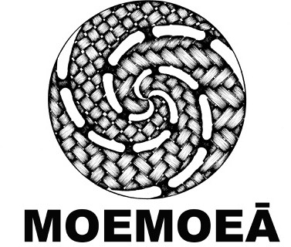
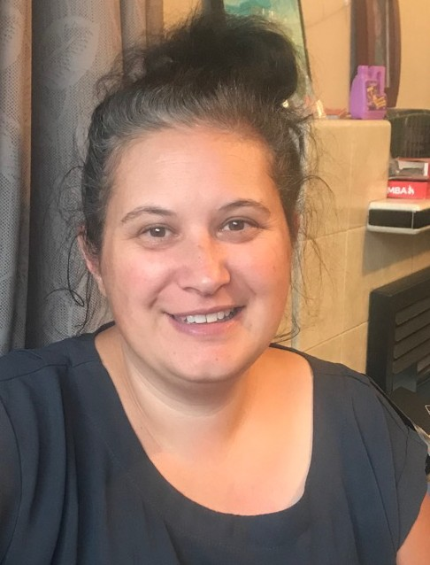
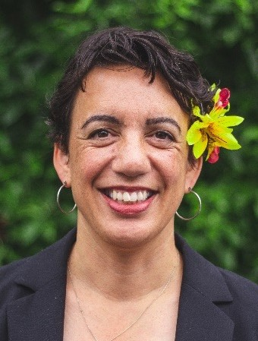
Moemoeā: sleep, health and
wellbeing for pēpi and their whānau
Project leadership
Medicine University of Otago Prof Rachael Taylor
Māori leadership
Medicine University of Otago
Assoc Prof Justine Camp
(Kai Tahu)
Pacific leadership
Centre for Pacific Health, University of Otago Prof Rosalina Richards
(Samoan) In collaboration with Moana Connect

Slide 2
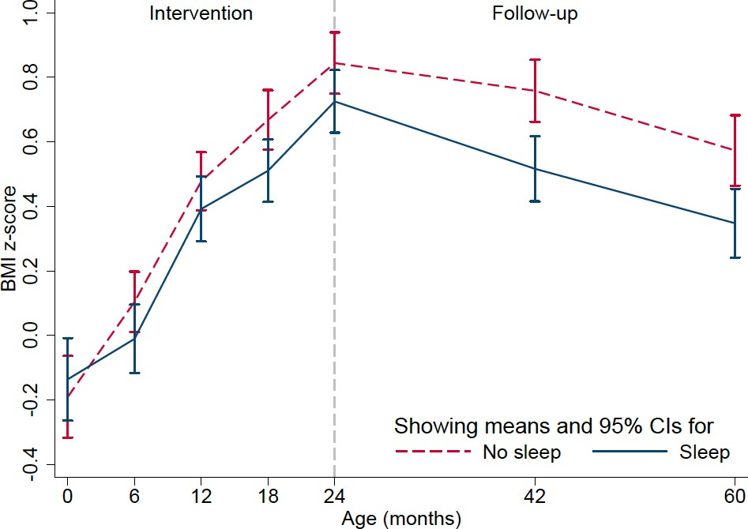
Sleep may be a novel tool for
improving
weight and wellbeing in pēpi
Taylor et al. AJCN 2018;108:228

Slide 3
But!
How well did it work for different groups within the population?
Clear that many of our existing sleep guidelines do not fit the lived realities of many whānau
They are not necessarily the messages they want or believe
So how can we do it better?

Slide 4
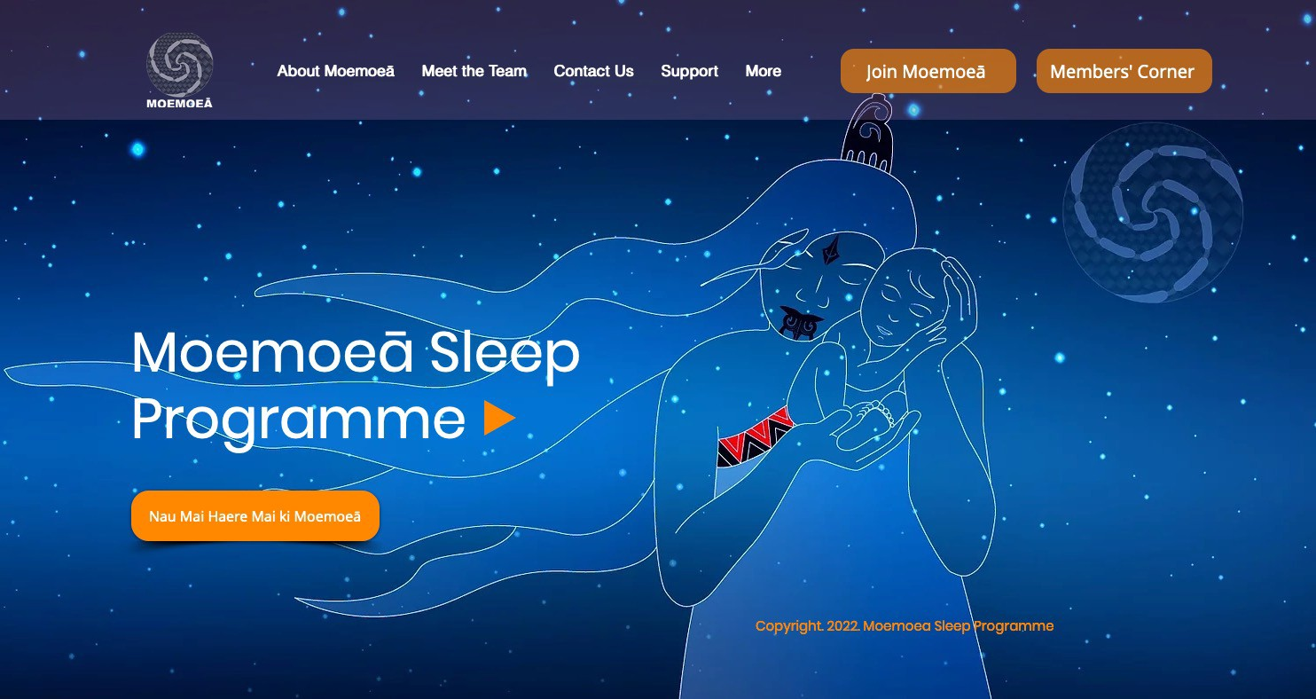

Slide 5
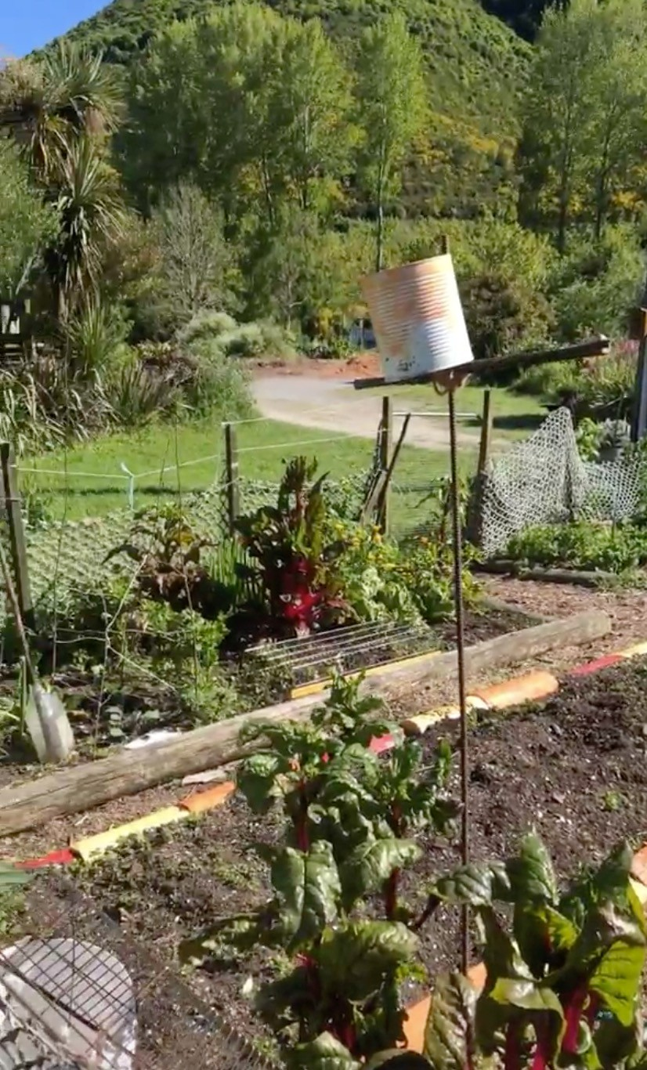
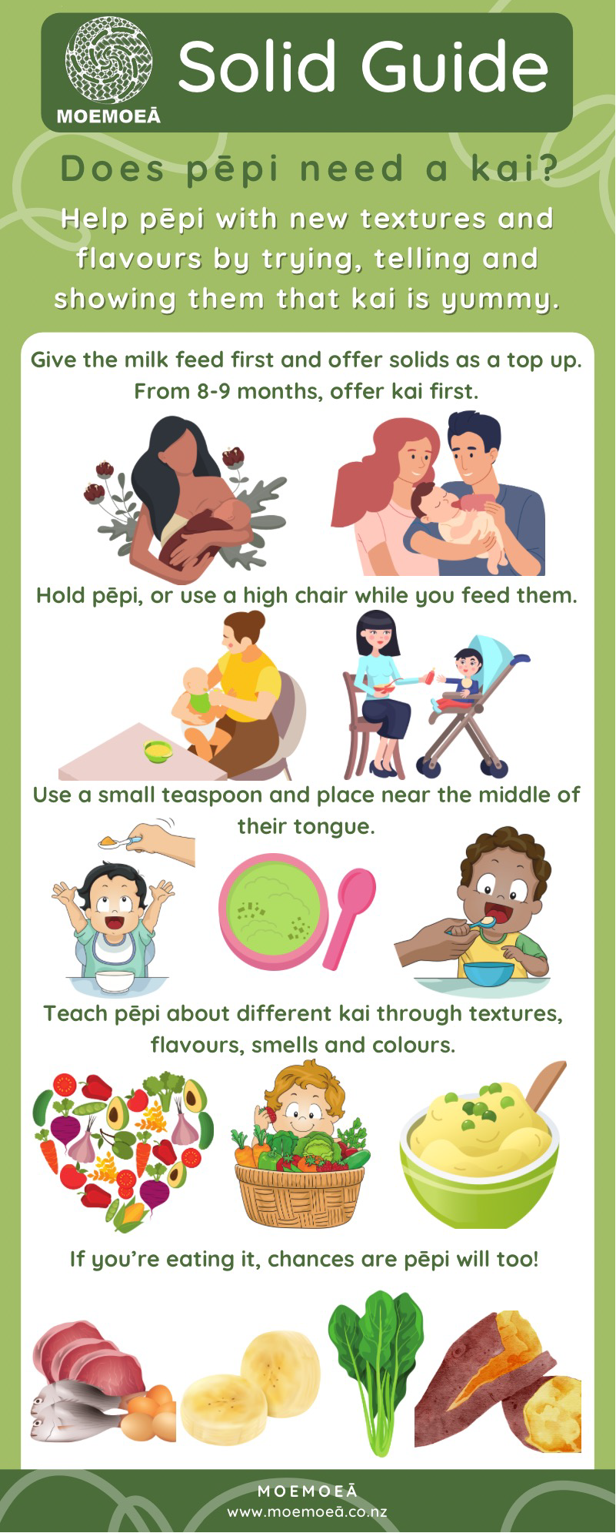
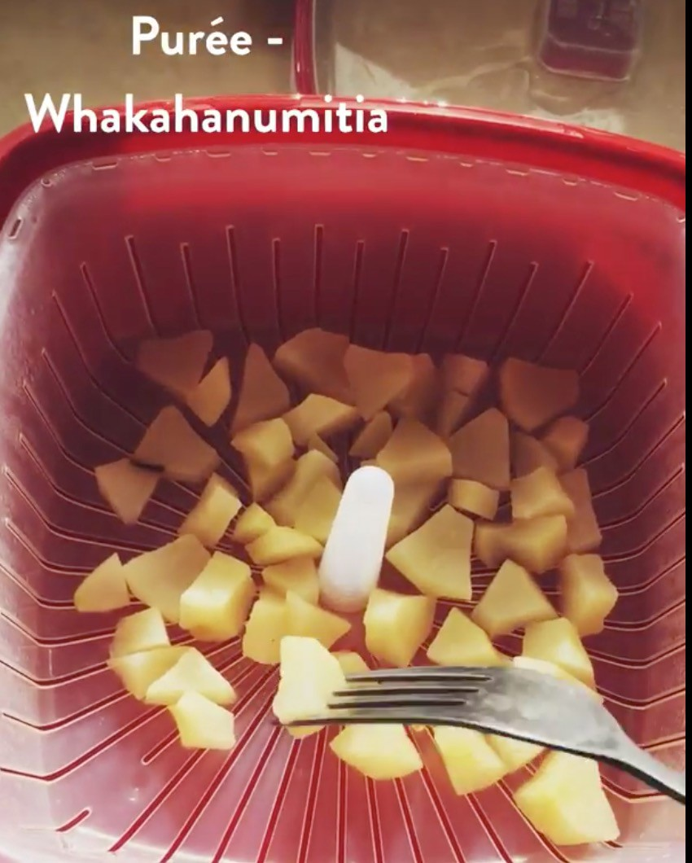
Pou 1: Rongo
Using wai, kai, and nature to create calm before bed
Wātaka
Kāri kai - infographics Kiriata kai - videos Whānau kai - recipes Whānau kai in our whare

Slide 6
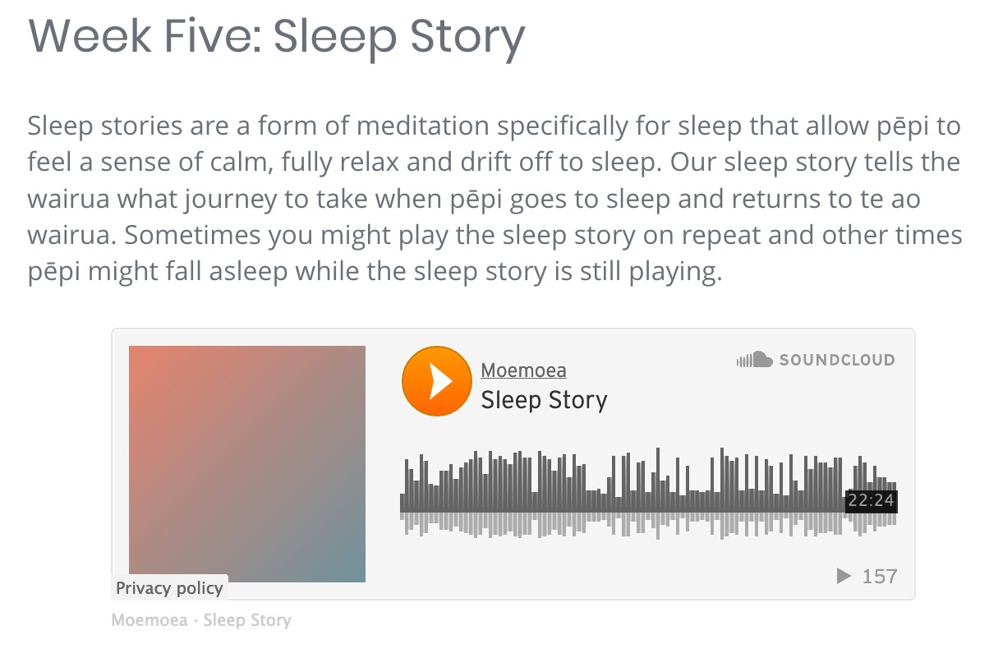
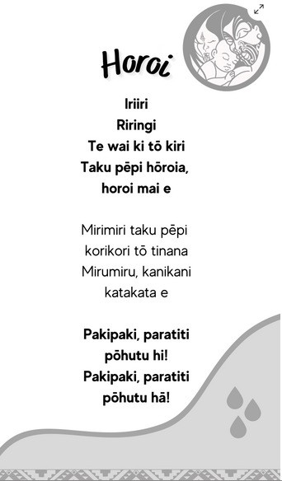
Pou 2: Uru
The transition to sleep phase
Horoi Mirimiri Karakia moe Oriori
Sleep story
All with audio and lyrics

Slide 7
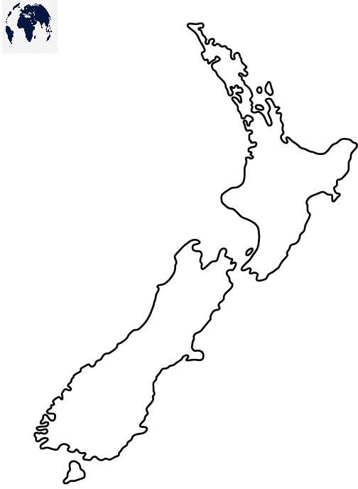
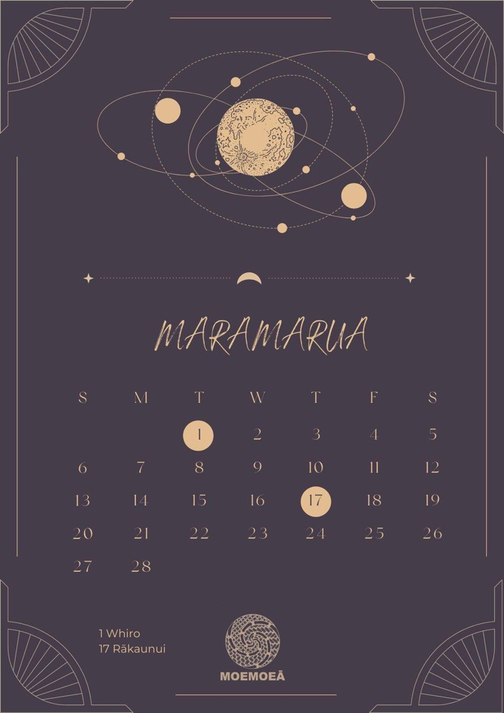
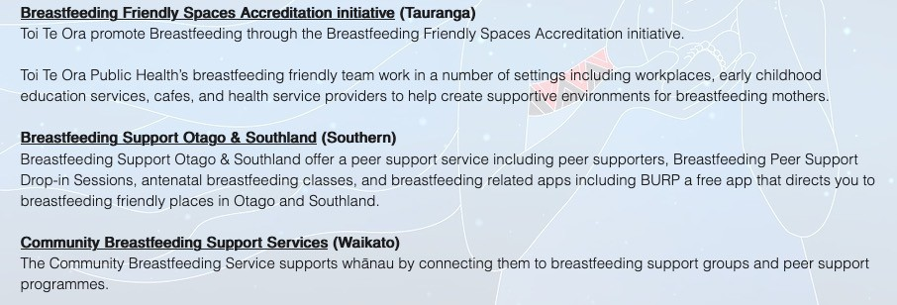
Pou 3: Whānau support
Building your own waka
“This activity is designed to remind whānau of existing strengths, while also providing ideas and directing whānau towards other forms of support that made the journey through parenthood a bit easier”

Slide 8
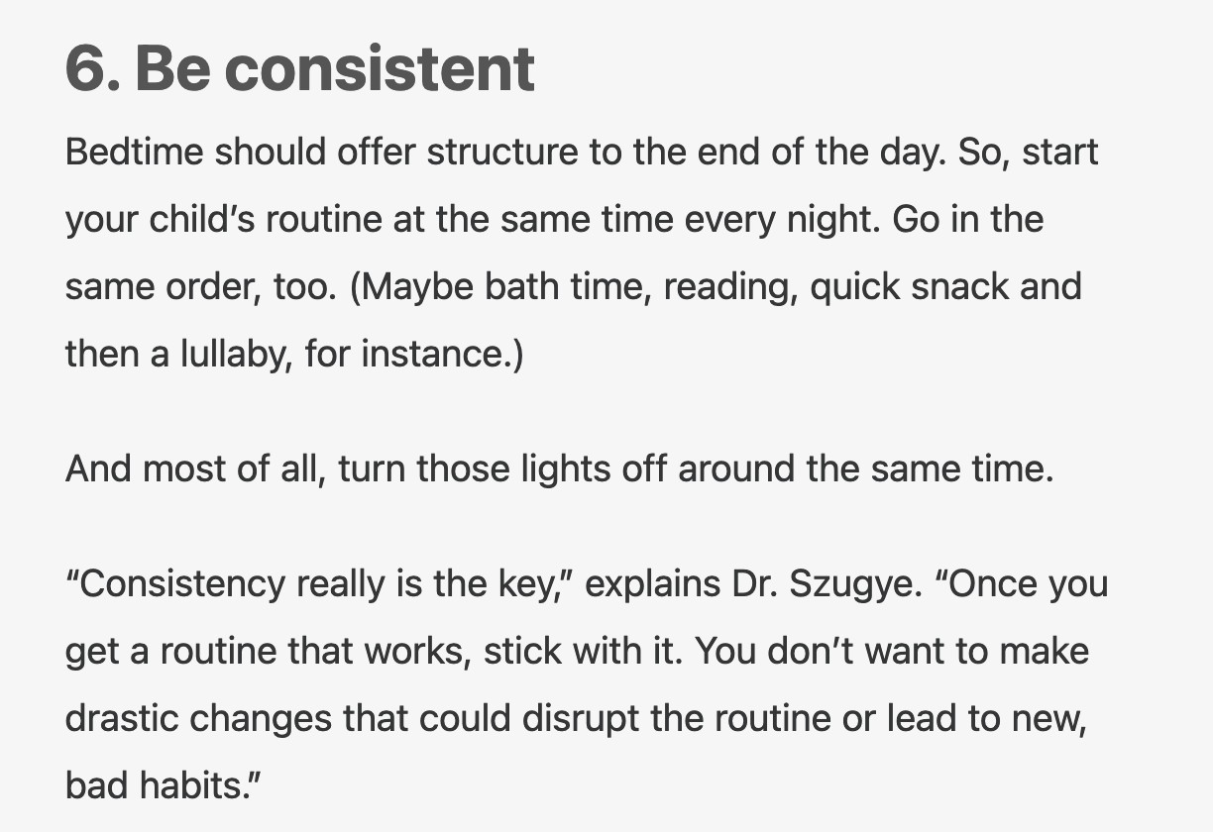
How is Moemoeā different? e.g. the Western concept of bedtime routines
“It’s a good idea to keep your child’s bedtime routine and bedtime at around the same time each night.”

Slide 9
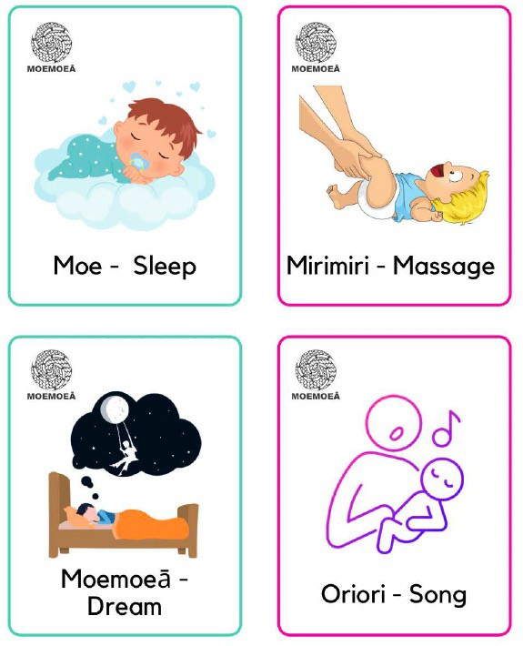
How is Moemoeā different?
We use ritual rather than routine
keeps many of the essential elements, but
adds connection to te ao Māori
and removes time pressure that can produce guilt

Slide 10
Group | Rongo | Uru | Whānau
1 | No | No | No
2 | No | No | Yes
3 | No | Yes | No
4 | No | Yes | Yes
5 | Yes | No | No
6 | Yes | No | Yes
7 | Yes | Yes | No
8 | Yes | Yes | Yes
Three
components tested via MOST

Slide 11
Group | Rongo | Uru | Whānau
1 | No | No | No
2 | No | No | Yes
3 | No | Yes | No
4 | No | Yes | Yes
5 | Yes | No | No
6 | Yes | No | Yes
7 | Yes | Yes | No
8 | Yes | Yes | Yes
Three
components tested via MOST

Slide 12
Group | Rongo | Uru | Whānau
1 | No | No | No
2 | No | No | Yes
3 | No | Yes | No
4 | No | Yes | Yes
5 | Yes | No | No
6 | Yes | No | Yes
7 | Yes | Yes | No
8 | Yes | Yes | Yes
Three
components tested via MOST

Slide 13
Participants
506 whānau
180 (36%) caregivers identify as Māori
232 (46%) pēpi identified as Māori
NZDep: 39% high (8-10), 22% low (1-3)
From all over NZ
Pēpi 6.1 (3) months of age (range 2-12m)
Recruited via 3 Māori health Providers, Plunket and social media

Slide 14
Māori cohort
93% Māmā
Education: 33% high school, 31% post-school, 36% tertiary
35% had 3 or more adults in household, 35% 3+
children, 25% multi-generational

Slide 15
We had to develop new outcome measures
Sleep
Traditional questions very deficit focused
We developed and validated a new scale focused on perception (POITSS)
Assessed impact of Uru
Connection
Our way of assessing Rongo
E.g. How often did you use waiata or karakia while
you were cooking and pēpi or other whānau were with you?
Wellbeing
Minor adaptations to WHO-5

Slide 16
What did our qualitative findings tell us?
Just over 1/3 of participants said our resources were useful or very useful
Focusing on sleep perception led to whānau feeling less stressed and less judged
Main themes
whānau felt more connected to their pepi, to te reo, and to Māori culture
thought pepi were calmer and and more settled

Slide 17
Minimal effect of the intervention
Measure | Condition | Mean difference (95% CI) | P-value
POITSS | Uru | 0.2 (-0.2, 0.5) | 0.283
(scale 0-10) | Rongo | 0.3 (-0.1, 0.6) | 0.133
 | Whānau support | 0.4 (0.0, 0.7) | 0.032
WHO-5 | Uru | -0.2 (-0.9, 0.6) | 0.694
(scale 0-25) | Rongo | 0.1 (-0.7, 0.8) | 0.889
 | Whānau support | 0.5 (-0.3, 1.3) | 0.184
Connection | Uru | 0.0 (-0.2, 0.2) | 0.905
(scale 0-8) | Rongo | -0.1 (-0.4, 0.1) | 0.243
 | Whānau support | 0.1 (-0.1, 0.4) | 0.220

Slide 18
Where there any interactions?
POITSS
Uru and Rongo small synergistic interaction
Uru and Support small synergistic interaction
Rongo and Support small antagonistic interaction
WHO-5
Uru and Support small antagonistic interaction
Connection
Uru and Support small synergistic interaction
Rongo and Support small antagonistic interaction

Slide 19
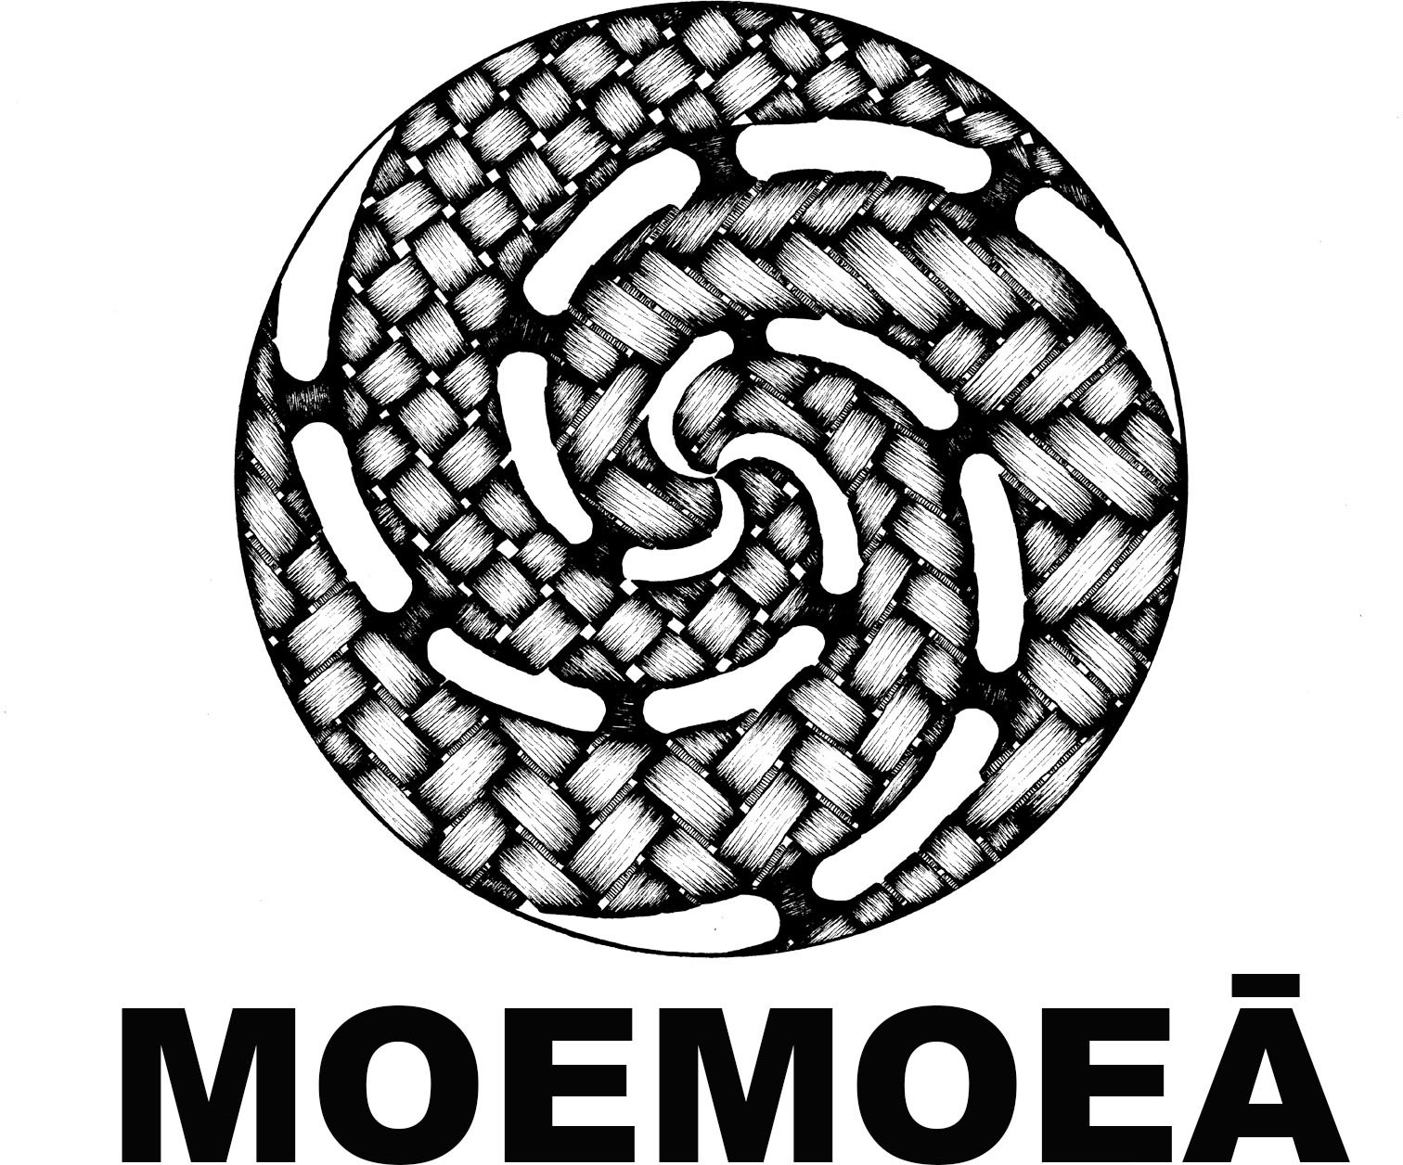
Why limited effect?
Lot of technical issues
25% drop-out (no final data)
Mixed uptake?
78% accessed website
62% accessed app
60% completed any steps
36% completed all steps
During COVID-19 pandemic

Slide 20
So where to from here?
Does not fit a Māori world view to separate!
Keeping Uru and Rongo
Working with communities and providers to develop further – other components will be added (Hine)
Will be tested in new RCT with Māori providers as part of HRC Programme grant
Continue developing surveys that decolonize data, making sure the measure and the intervention work in synergy

Slide 21
Investigators
Rachael Taylor
Rose Richards
Lou Fangupo
Jill Haszard
Justine Camp
Takiwai Russell-Camp
Talia Ellison
Barbara Galland
Jacinta Faalili-Fidow and colleagues (Moana Connect)
Tania Cargo
Barry Milne
Wayne Cutfield
Lisa Daniels
Barry Taylor
Huhana Ramsey (COMET)

