Slide 1
A Better Start
Whiriwhiria: kia ora ai te tamaiti
David Tipene-Leach
Te Kura i Awarua Rangahau Māori Research Centre

Slide 2
BACKGROUND: Whiriwhiria, kia ora ai te tamaiti: Building health, wellbeing (and learning success) for tamariki and rangatahi through Mātauranga Māori and systems science approaches
Nourishing Hawke’s Bay: He wairua tō te kai (Ka Ora, Ka Ako: MM and SD)
HB: high inequities and childhood obesity
Nationally: A failing food system: inequities in health, wellbeing and food security
Globally: child health, wellbeing, early learning and resilience are complex
Demonstrating, at a regional level, how mātauranga Māori and science-led interventions across nutrition, (learning, and movement) can improve the health and wellbeing, and the learning of tamariki and rangatahi.

Slide 3
BACKGROUND: Whiriwhiria, kia ora ai te tamaiti: Building health, wellbeing (and learning success) for tamariki and rangatahi through Mātauranga Māori and systems science approaches
AIMS:
To evaluate the effectiveness of current food, learning and movement initiatives in Hawke’s Bay with particular regard to outcomes for tamariki Māori
To explore how mātauranga Māori can inform the development of a comprehensive systems dynamics science approach and reorient food systems in the Hawke’s Bay
To create an Indigenous informed and inspired food systems approach to improve health, wellbeing, resilience and educational outcomes for tamariki, rangatahi and whānau.

Slide 4
METHODS: Systems science and programme evaluation methods embedded in mātauranga Māori
Workstream 1: Impact evaluations
School and Community case studies (Finished/parked)
Ka Ora, Ka Ako Impact Evaluation (In analysis)
Workstream 2: Integrative models
Ka Ora, Ka Ako quantitative SD models: in the HB region
Value for Investment: alternative to standard cost-benefit analysis
Regional food system map and action plan: CM/GMB/asset registry.
Workstream 3: Catalysed actions
Policy pathways analyses: Lit RV and workshops for impact of Ka Ora, Ka Ako
Rangatahi-developed food and wellbeing guidelines

Slide 5
METHODS: Systems science and programme evaluation methods embedded in mātauranga Māori
Workstream 2: Integrative models
1. Ka Ora, Ka Ako quantitative SD models: in the HB region
2. Value for Investment: alternative to standard cost-benefit analysis
3. Regional food system map and action plan: CM/GMB/asset registry.
Workstream 3: Catalysed actions
1. Policy pathways analyses: Lit RV and workshops for impact of Ka Ora, Ka Ako
2. Rangatahi-developed food and wellbeing guidelines
Results Impact
Implementation

Slide 6
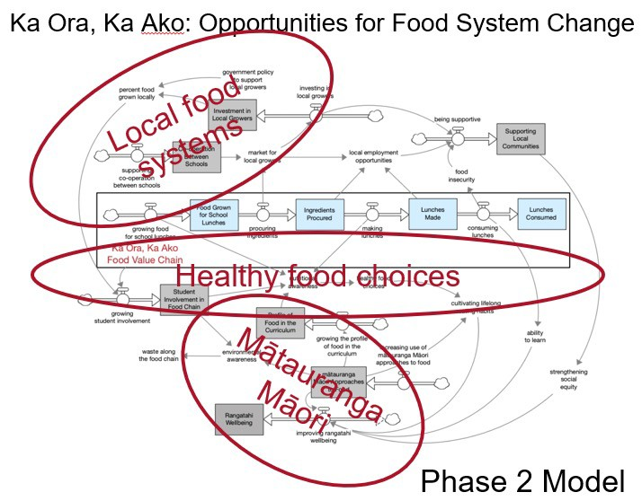
Results: Ka Ora, Ka Ako quantitative SD models
(Integrative model 1)
Ka Ora Ka Ako Phase 1 Model (This is what we know already)
Ka Ora Ka Ako Phase 2 Model
(What opportunities do we have for food system change using Ka Ora Ka Ako as a platform?)

Slide 7
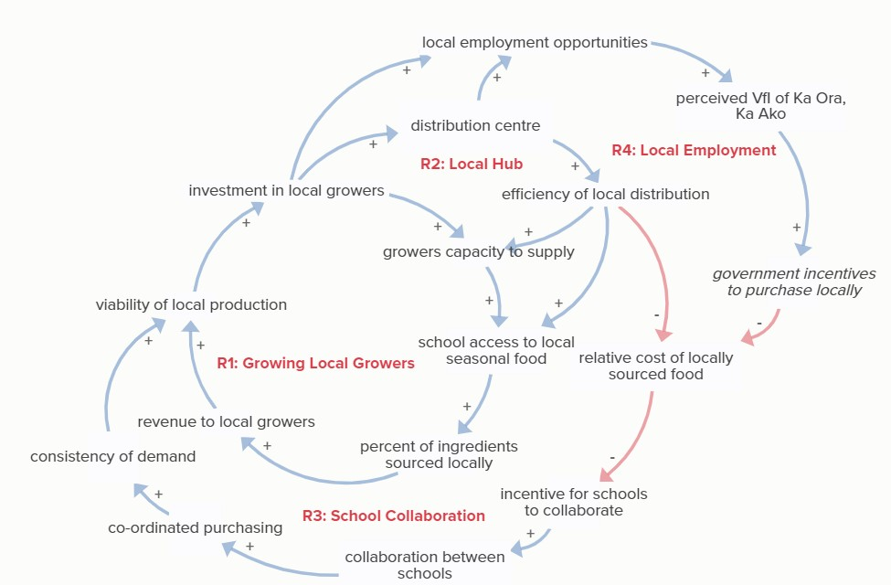
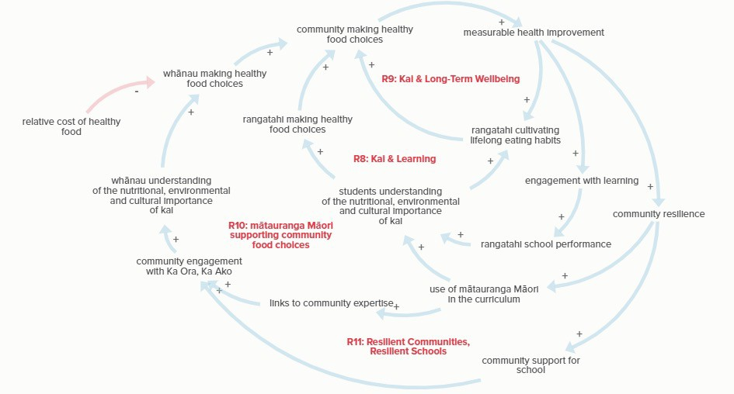
Results: Using Ka Ora, Ka Ako as a platform for change
Research question: How can Ka Ora, Ka Ako contribute to the development of a
local sustainable food system in HB
Locally grown food
Set of 3 workshops (2 done)
Community vision:
Maximize use of locally grown food
Use of mātauranga Māori in curriculum
Helping people make healthy food choices
Improve access to affordable, healthy food
Making healthy food choices

Slide 8
Implementation: Ka Ora Ka Ako Phase 3
IVs/Surveys on
Intervention pathways
Resource requirements
Business partnerships
Governance structures
Necessary alternative actions given present politics

Slide 9
Impact: Value for Investment framework
(Integrative model 2)
What’s the value proposition for Ka Ora Ka Ako?
Stakeholders: what values are expected

Slide 10
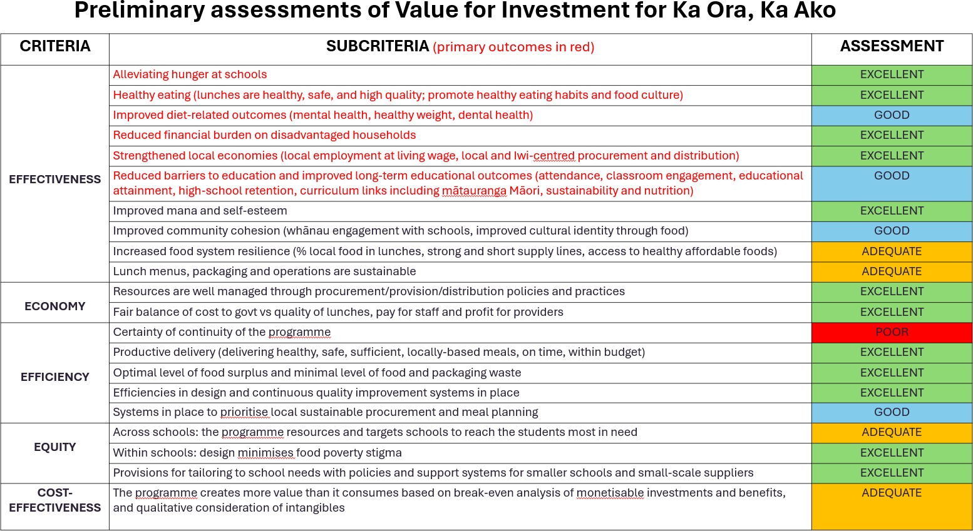
Impact and Implementation: Value for Investment framework.
Of 21 assessment areas:
12 excellent; 4 good; 4 adequate; 1 poor
Main areas for improvement
Secure funding system
Future vision - all children in need,
- all schools
Sustainability eg menu planning and procurement policies
A formal cost-effectiveness study
Long-term monitoring of educational and health outcomes

Slide 11
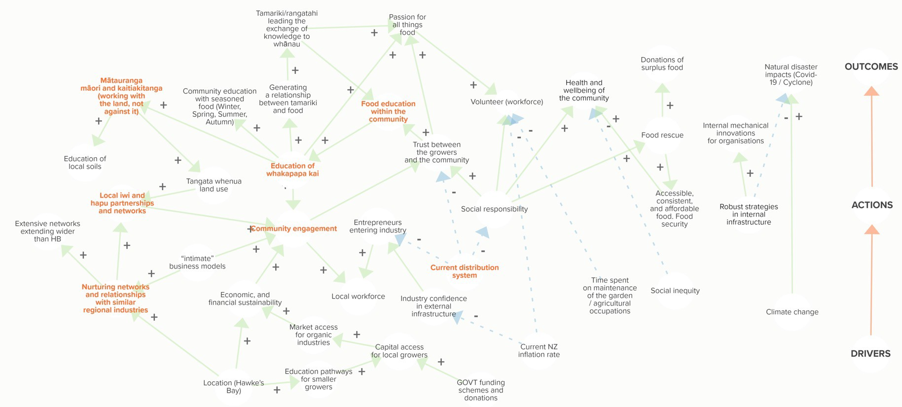
Implementation: Cognitive mapping of food networks in Hawke’s Bay
(Integrative model 3)
Most common themes
Community engagement
Health and wellbeing
Robust, innovative design
Inflation rates/food expense
Local networks/partnerships
Mātauranga Māori
Location
Impact of natural disasters
Education on kai
Current distribution systems
•
Food Road Map: Preparation for the bigger regional picture

Slide 12
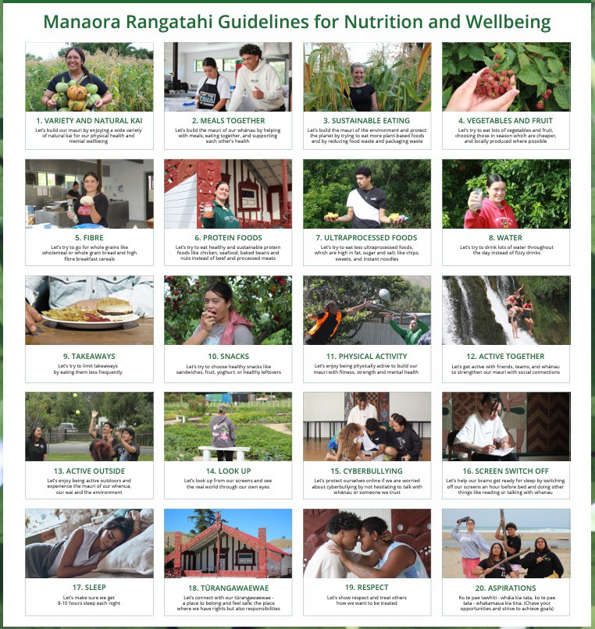
Results: Rangatahi guidelines
(Catalyzed action 1)
Dietary habits : childhood and adolescence
Current guidelines don’t resonate with rangatahi
17 rangatahi participated in two wānanga
Nutrition and wellbeing guidelines
‘Let’s’, rather than ‘must’ Incorporated mātauranga Māori Incorporated environment messages Incorporated wellbeing messages
Eg: MH/sleep/cyberbullying/tūrangawaewae/ respect/whakatauki/)

Slide 13
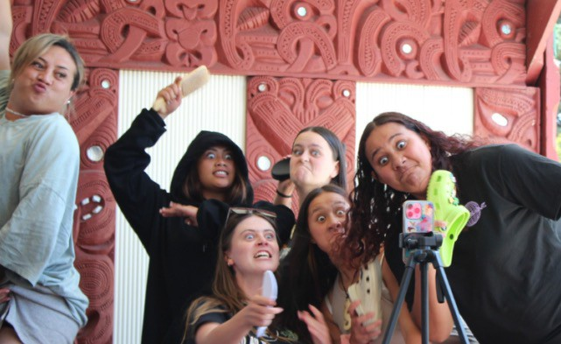
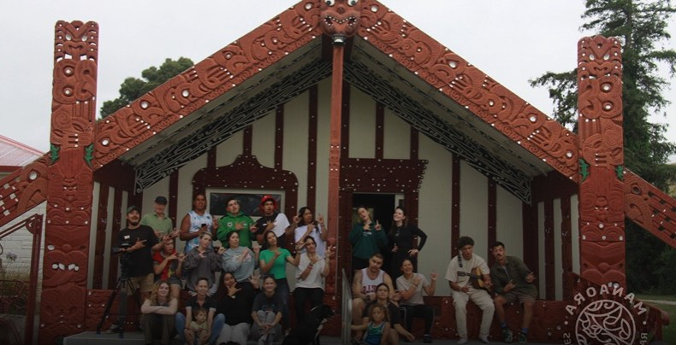
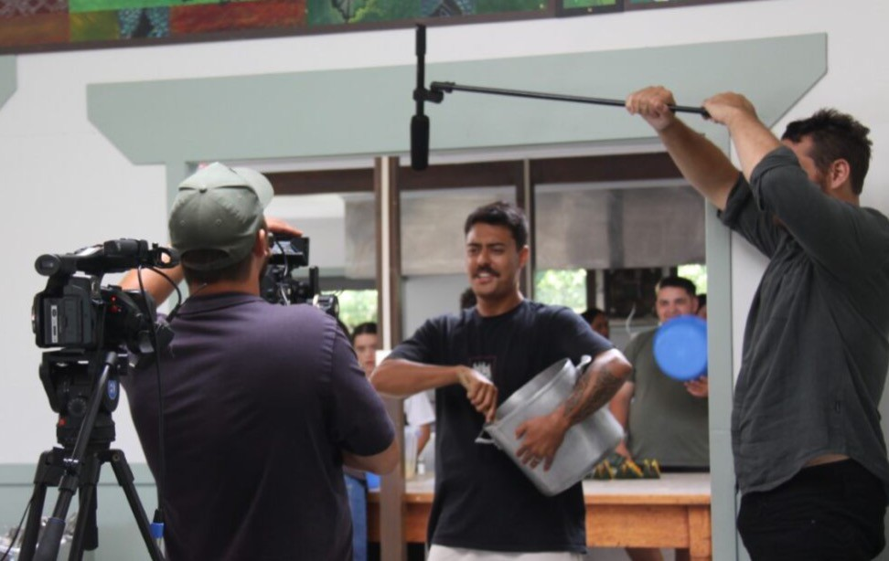
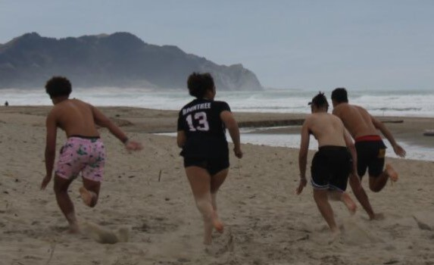
Implementation: Rangatahi guidelines
20 wk Social media campaign
Feature prominent NZ influencers
Rangatahi leadership
Media engagement: Te Karere, TikTok, Instagram, youtube
Incorporate into curriculum (schools, EIT, Healthy active learning, training)
https://nourishinghawkesbay.org/manaora- rangatahi-campaign/

Slide 14
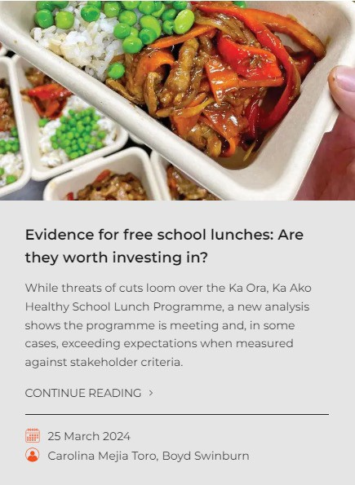
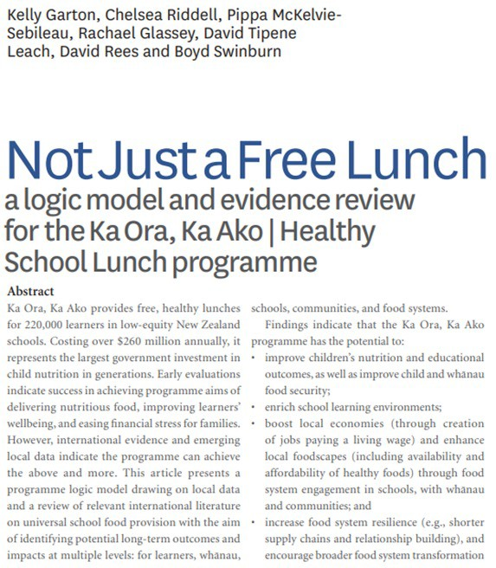
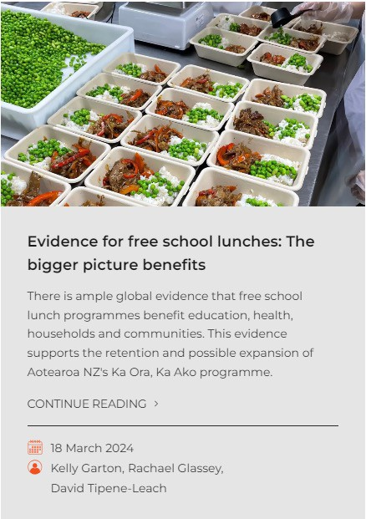
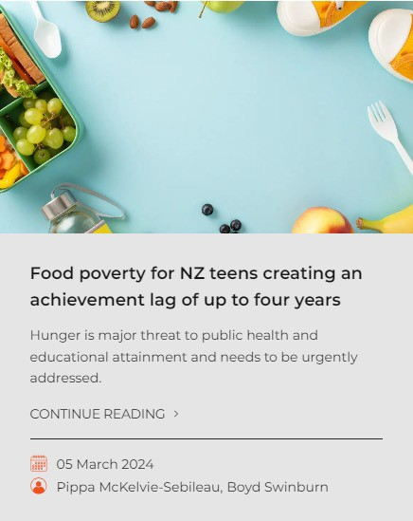
Impact: Policy papers, briefings
& webinars
(Catalyzed action 2)
The Briefing, Public Health Communications Centre

Slide 15
Next steps (Endeavour grant submitted)
Co-create the knowledge needed to accelerate collective actions for regional food
systems transformation using a platform of participatory research methods and
mātauranga Māori across five innovation areas:
Food citizenship (knowledge, skills, engagement) Manaora and He Kai Whakaora
Ka Ora, Ka Ako 2.0 (innovating the school lunch programme)
New ‘food rescue and waste’ systems (food to people, not landfill)
New systems doing ‘local food to local people’ (stronger local food ecosystem)
Systems integration (integration into a regional model)
Transform regional food systems by collaborating across the entire food chain,
including education, health, government, communities, and all age groups.
Empower Hawke's Bay to shape regional food systems in alignment with their
goals, while also engaging with other regions and policymakers to enhance the food policy environment.

Slide 16
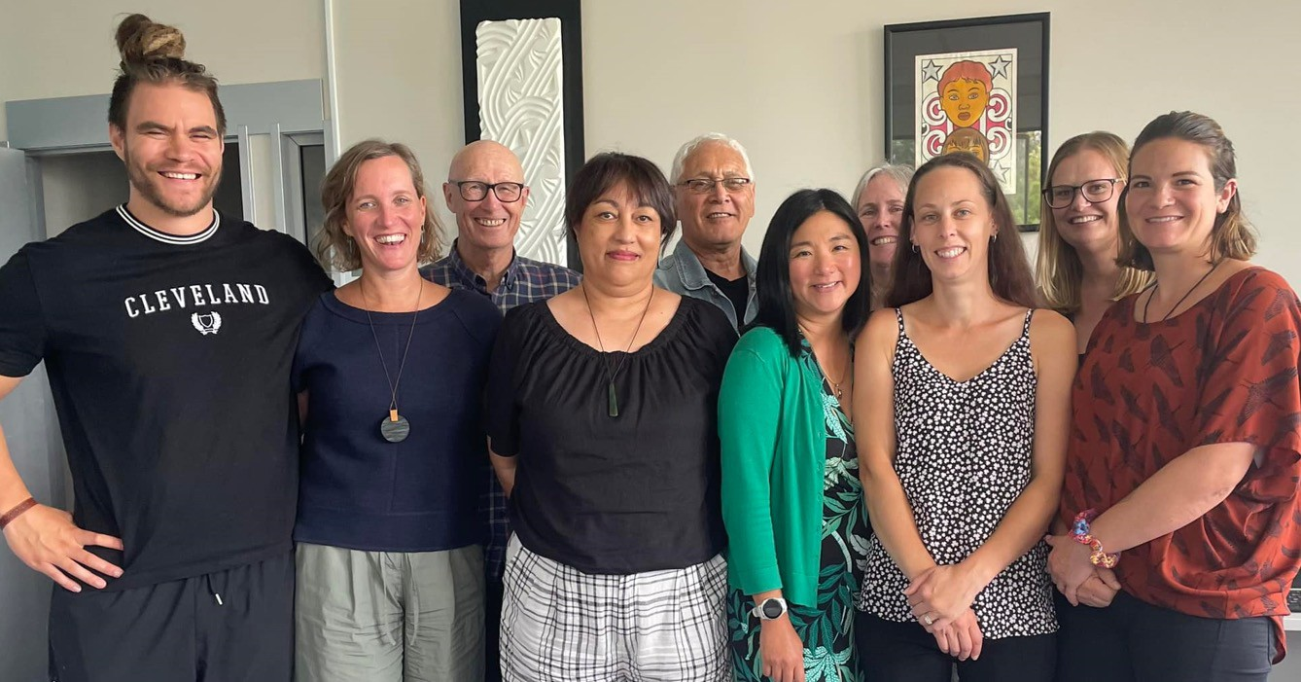
Thanks from NHB

Slide 17
Hosted by the Liggins Institute at the University of Auckland
Funded by the Ministry of Business, Innovation and Employment

